Slide 1
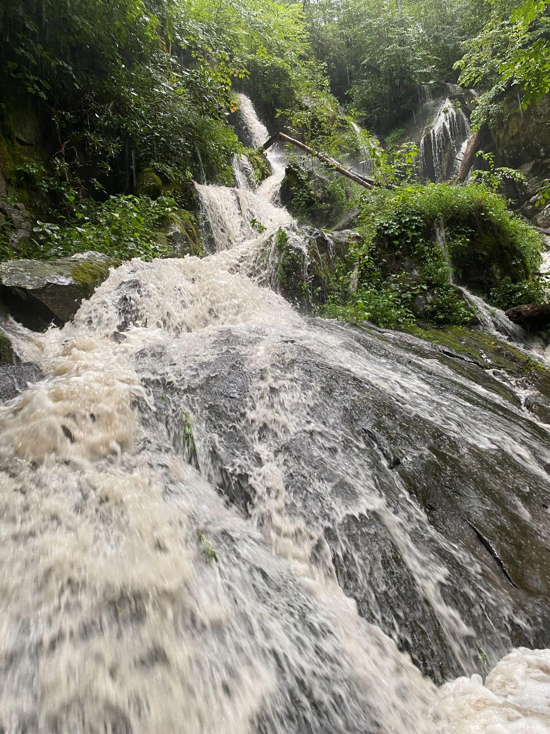
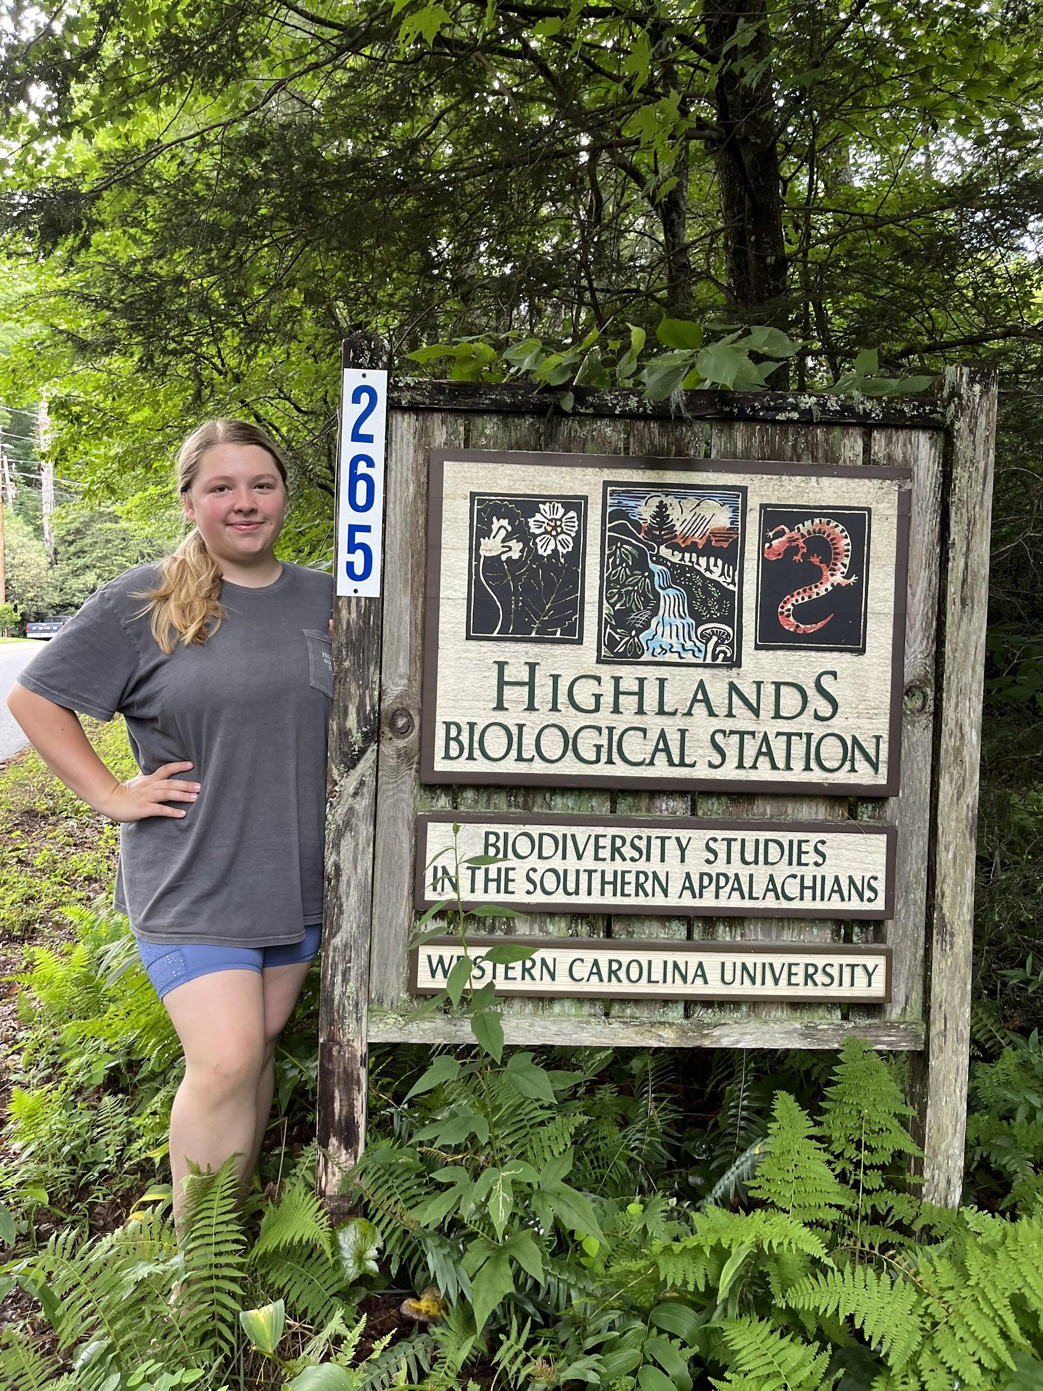
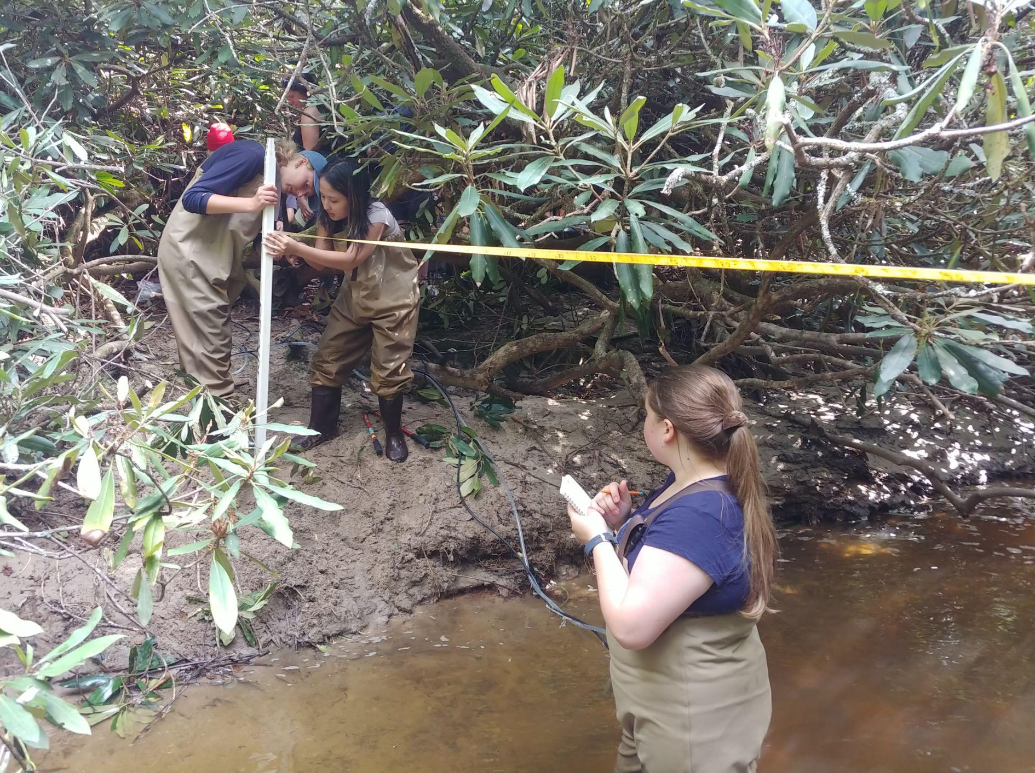
BIG STORMS, LITTLE PLASTICS:
Microplastic Concentrations and Dynamics in Headwater Streams in the Southern Appalachian Mountains
Chloe Hall
B.S. Environmental Science, GIS Minor
Faculty Advisor: Dr. Radmila Petric, UNC Institute for the Environment
Principal Investigator: Jason Love, Highlands Biological Station

Slide 2
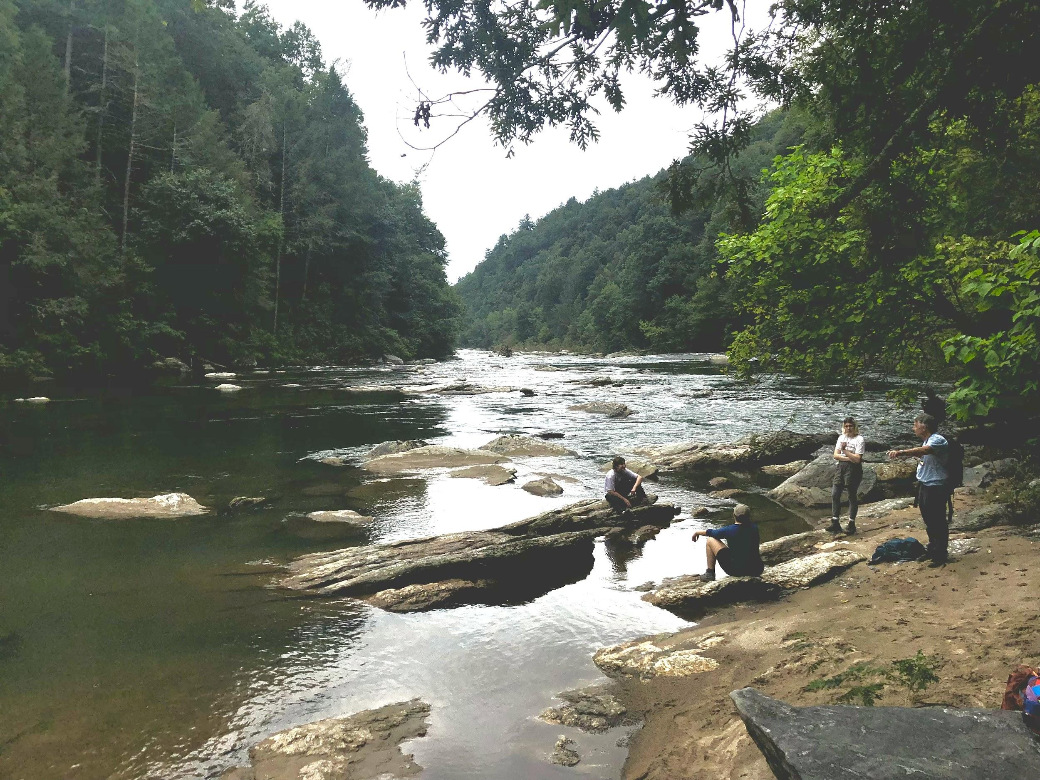
Project Description
Worked to investigate the presence of microplastics in the headwaters of the southern Appalachians.
Microplastics are defined as plastic particles less than 5 mm in length.
1
Study Location
3
The southern Appalachian Mountains serve as the “water towers” for the Southeast, as many important rivers are born in the mountains.
2
Conduct a secondary analysis to verify findings.
With the help of Dr. Austin Gray from Virginia-Tech, I learned how to use a Raman Spectrometer to determine the chemical composition of the particles that we collected from our stream samples.
Project Significance
4
Despite the importance of these headwater streams to humans and aquatic organisms, no published studies have investigated the presence of microplastics in these watersheds.
.
Image of Section IV of the Chattooga River.

Slide 3
Results
Microplastic concentrations increase during storm events.
Microplastics were detected in atmospheric deposition.
2
Preliminary findings from this project revealed high concentrations of microplastics in the Chattooga River during a single storm event that exceeded 50,000 MPs/m3, which is among the highest levels ever recorded in freshwater river systems.
1
In addition to our stream samples, this study also analyzed atmospheric deposition (rainfall) for microplastics.
Significant environmental implications
Approximately 82% of the collected particles were confirmed as artificial particles.
4
3
These preliminary results indicate a pressing need for further research into the sources of microplastic pollution in the southern Appalachians and potential ways to mitigate this issue.
With the help of Raman spectroscopy (a specialized microscope that helps to determine the exact chemicals that make up a particle), we determined that 82% of a subset of our collected particles were anthropogenic (created by humans).
Specifically, 30.4% were confirmed anthropogenic fibers and 39.1% were confirmed as microplastics.
The streams that were sampled in this study were in some of the most pristine, forested regions of the Appalachians. These are the headwaters for the Southeast, any contamination in this region has a significant ecological domino effect throughout this entire region.

