Slide 1
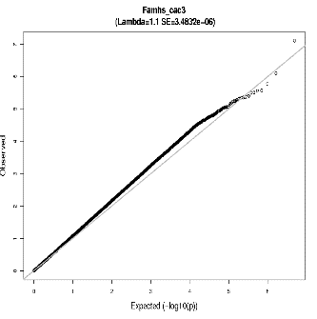
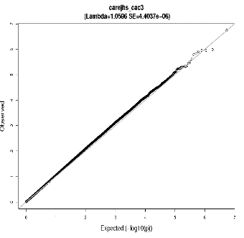
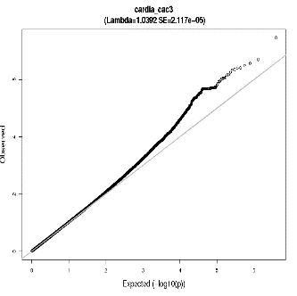
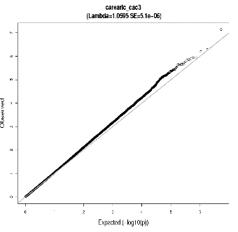
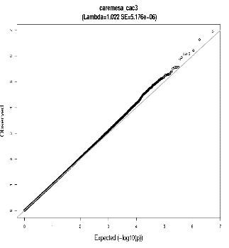
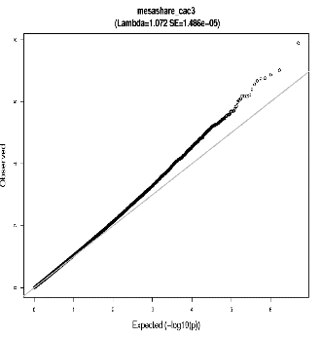
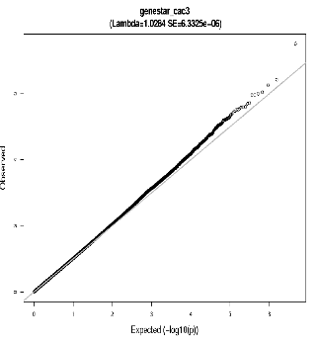
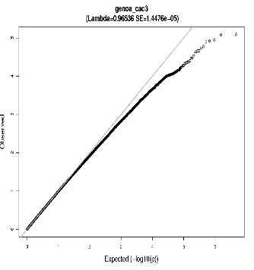
FamHS
λ=1.1 SE=3.48E-06
JHS
λ=1.0596 SE=4.40E-06
CARDIA
λ=1.0392 SE=2.12E-05
JHS-ARIC
λ=1.0595 SE=5.1E-06
MESA
λ=1.022 SE=5.18E-06
MESA Family/Air
λ=1.072 SE=1.49E-05
GeneSTAR
λ=1.0284 SE=6.33E-06
GENOA
λ=0.96536 SE=1.45E-05

