Slide 1
Improving predictions of coastal flooding via sub-mesh corrections
Johnathan Woodruff¹, J.C. Dietrich¹
A. Kennedy², D. Wirasaet², D. Bolster², Z. Silver², R. Kolar³ ¹North Carolina State University – Raleigh, NC, ²University of Notre Dame – South Bend, IN, ³University of Oklahoma – Norman, OK

Slide 2
Introduction
High resolution is computationally costly
Hinders the speed of ADCIRC runs
Delays the forecast predictions
This study aims to increase the accuracy and efficiency of ADCIRC by:
Adding sub-mesh correction factors to the governing equations
Running on coarsened meshes

Slide 3
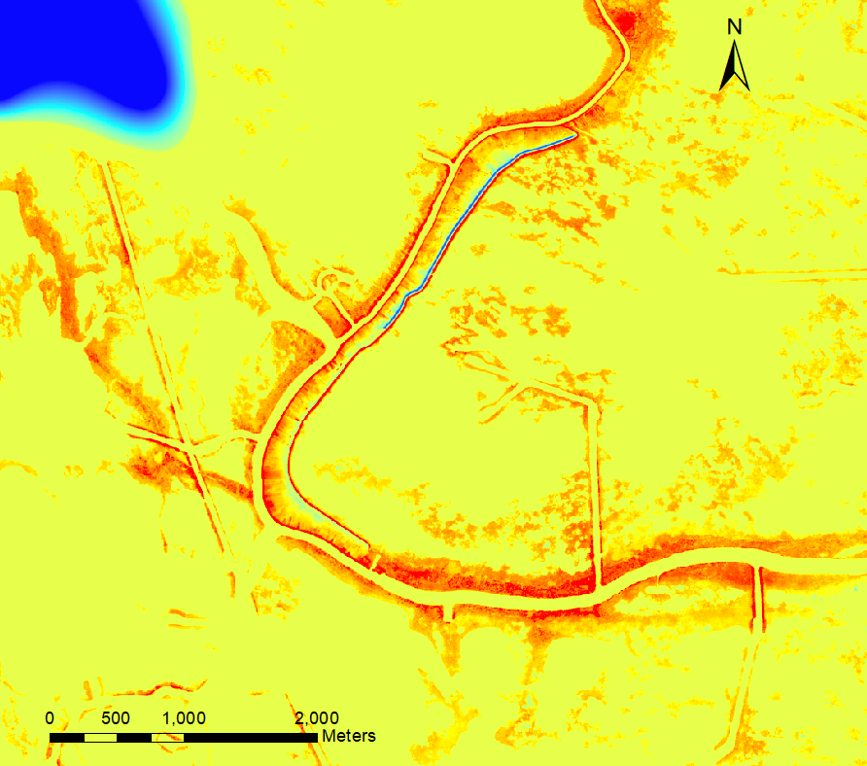
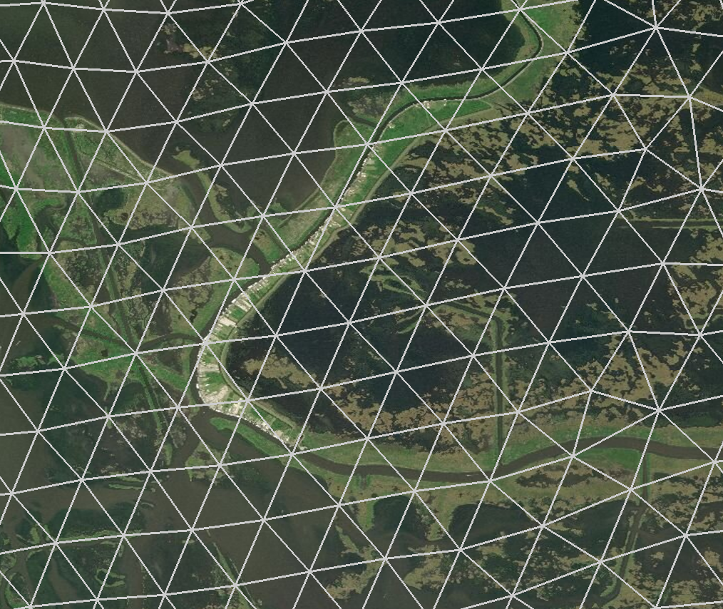
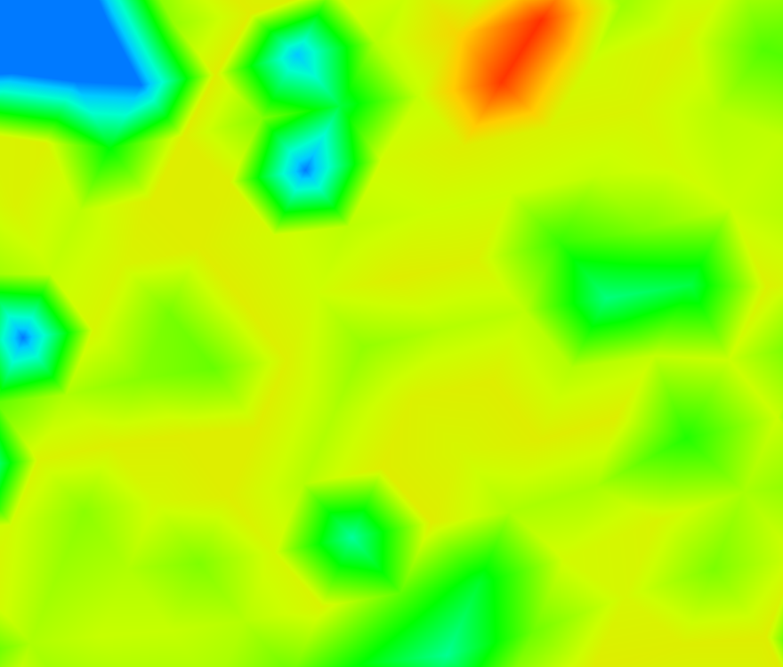
1.
2.
NOMAD mesh v1e MSL (HSOFS)
This mesh is used in real-time forecasting by NOAA and the ADCIRC Prediction System (APS).
High resolution bathymetry surrounding Delacroix, LA
3.
Interpolated bathymetry of the mesh
Caernarvon Marsh, LA

Slide 4
Sub-mesh Features
Sub-mesh features:
Hydraulic features that influence flow
Exist below the resolution of the mesh
Include: small scale channels, ponds, marsh grasses, and roadways
Pond
50-100 m
Tidal Channel
10 m
Marsh Grass

Slide 5
Theory
The primitive shallow water equations were first averaged using techniques outlined in Kennedy et al. 2019.
These averaged primitive equations were then transformed into the GWCE and conservative momentum equations ADCIRC uses.

Slide 6
Averaged Variables Theory
To obtain the averaged variables we integrate inside each element.
A given dummy variable $Q$ would be averaged as follows:
$${〈Q〉}_{G}≡\frac{1}{A_{G}}\iint_{A_{W}}{QdA}$$
$${〈Q〉}_{W}≡\frac{1}{A_{W}}\iint_{A_{W}}{QdA}$$
$$\&$$
Where: $A_{W}=φA_{G}$

Slide 7
GWCE Conversion
$\frac{∂^{2}ζ}{∂t^{2}}+τ_{0}\frac{∂ζ}{∂t}+\frac{∂{\tilde{J}}_{x}}{∂x}+\frac{∂{\tilde{J}}_{y}}{∂y}−UH\frac{∂τ_{0}}{∂x}−VH\frac{∂τ_{0}}{∂y}=0$
$φ\frac{∂^{2}{〈ζ〉}_{W}}{∂t^{2}}+φτ_{0}\frac{∂{〈ζ〉}_{W}}{∂t}+\frac{∂{〈{\tilde{J}}_{x}〉}_{W}}{∂x}+\frac{∂{〈{\tilde{J}}_{y}〉}_{W}}{∂y}−{〈U〉}_{W}{〈H〉}_{G}\frac{∂τ_{0}}{∂x}−{〈V〉}_{W}{〈H〉}_{G}\frac{∂τ_{0}}{∂y}=0$
Where:
$φ$ is the wet area fraction
Subscripts ${〈〉}_{W}$ and ${〈〉}_{G}$ mean the variable was averaged over the wet area or whole area respectively

Slide 8
GWCE Conversion
$${〈{\tilde{J}}_{x}〉}_{W}=−\frac{∂{〈U〉}_{W}{〈U〉}_{W}{〈H〉}_{G}}{∂x}−\frac{∂{〈V〉}_{W}{〈U〉}_{W}{〈H〉}_{G}}{∂y}+f{〈V〉}_{W}{〈H〉}_{G}−g{〈h〉}_{G}\frac{∂{〈ζ〉}_{W}}{∂x}−φ\frac{g}{2}\frac{∂{〈ζ〉}_{W}^{2}}{∂x}$$
$$+φ{\left\langle \frac{τ_{sx}}{ρ_{0}}\right\rangle }_{W}−\frac{C_{f}\left|{〈U〉}_{W}\right|{〈U〉}_{W}{〈H〉}_{G}}{{〈H〉}_{W}}+\frac{∂}{∂x}\left(E_{h}\frac{∂{〈U〉}_{W}{〈H〉}_{G}}{∂x}\right)+\frac{∂}{∂y}\left(E_{h}\frac{∂{〈U〉}_{W}{〈H〉}_{G}}{∂y}\right)+τ_{0}{〈U〉}_{W}{〈H〉}_{G}$$
$${〈{\tilde{J}}_{y}〉}_{W}=−\frac{∂{〈U〉}_{W}{〈V〉}_{W}{〈H〉}_{G}}{∂x}−\frac{∂{〈V〉}_{W}{〈V〉}_{W}{〈H〉}_{G}}{∂y}−f{〈U〉}_{W}{〈H〉}_{G}−g{〈h〉}_{G}\frac{∂{〈ζ〉}_{W}}{∂y}−φ\frac{g}{2}\frac{∂{〈ζ〉}_{W}^{2}}{∂y}$$
$$+φ{\left\langle \frac{τ_{sy}}{ρ_{0}}\right\rangle }_{W}−\frac{C_{f}\left|{〈U〉}_{W}\right|{〈V〉}_{W}{〈H〉}_{G}}{{〈H〉}_{W}}+\frac{∂}{∂x}\left(E_{h}\frac{∂{〈V〉}_{W}{〈H〉}_{G}}{∂x}\right)+\frac{∂}{∂y}\left(E_{h}\frac{∂{〈V〉}_{W}{〈H〉}_{G}}{∂y}\right)+τ_{0}{〈V〉}_{W}{〈H〉}_{G}$$

Slide 9
Sub-mesh calculations
NODE 2
NODE 3
Sub-mesh calculations are performed using a high resolution digital elevation model (DEM) underlying a ADCIRC mesh of coarser resolution.
Sub-mesh correction factors such as $φ$, ${〈H〉}_{G}$, and ${\left\langle h\right\rangle }_{G}$ are found by integrating the sub-areas within each element.
Sub-mesh quantities are pre-computed and read into ADCIRC.
DRY
ELEMENT 3
PARTIALLY WET
ELEMENT 2
WET
ELEMENT 1

Slide 10
Sub-mesh calculations
NODE 2
NODE 3
Within the elemental loops of the GWCE and Momentum codes averaged variables are looked up based on water surface elevation at each vertex.
Averaged variables are also stored in vertex arrays to be used in wetting and drying and the nodal loops of the momentum code.
DRY
ELEMENT 3
PARTIALLY WET
ELEMENT 2
WET
ELEMENT 1

Slide 11
Sub-mesh in 2D
In 2D the elements are split up into 3 sub-areas.
Sub-mesh calculations are performed based on the DEM lying beneath the mesh for each sub-area within the element.
= WET
= PARTIALLY WET
= DRY

Slide 12
Sub-mesh in 2D
DEM Res
Divide element into 3 sub-areas based on the halfway points between vertices.
Divide each sub-area into 2 triangles
Refine each triangle into many smaller triangles that are roughly the same resolution as the sub-mesh
Apply DEM data to the smaller triangles
Average sub-mesh variables over each sub-area

Slide 13
Wetting and Drying
REALITY
TRADITIONAL ADCIRC
SUB-MESH ADCIRC
$$H_{min}$$
DRY
DRY
DRY
PARTIALLY
WET
DRY
WET
WET
WET

Slide 14
Wetting and Drying Algorithm
A totally new wetting and drying algorithm was used to replace the existing.
The wet/dry state of each vertex is determined based on the wet area surrounding the vertex.
Elemental wet/dry state is determined by the average wet area within each element.

Slide 15
Wetting and Drying Algorithm
BEGIN Wetting and Drying
ADJUST
$ζ$ of DRY vertices to the $\overline{ζ}$of the neighboring WET vertices
COMPUTE averaged variables $φ$, ${〈H〉}_{G}$, ${〈H〉}_{W}$
EVALUATE wet/dry state
$$φ≥φ_{dry}$$
END Wetting and Drying

Slide 16
Discretization
The discretization of the governing equations mimics the Conservative Version 1 discretization.
Conservative Version 1 assumes the un-differentiated terms are elementally averaged and uses a linear expansion in space for the conservative flux terms.

Slide 17
Results
Sub-mesh ADCIRC was run on a coarsened mesh to demonstrate its ability to accurately predict water surface elevations.
Traditional ADCIRC was run on both a coarsened and high resolution mesh as a baseline to compare sub-mesh results.

Slide 18
Model Setup
IM CODE
DT = 1 second
$τ_{0}$= 0.005
FFACTOR = 0.0025
ESLM = 2.0
No ramp
1 day runtime
Sub-mesh $φ_{dry}=0.25$
2 m diurnal tidal signal was used to force the model
Kolar-Gray Lat. Stress GWCE
1
2
1
2
1
1
Implicit Formulation
Cons. Form 1 Advec. GWCE
INTBP Velocity Based Lat. Stress
Corrected Area Integration Mom.
Cons. Form 1 Advec. Momentum

Slide 19
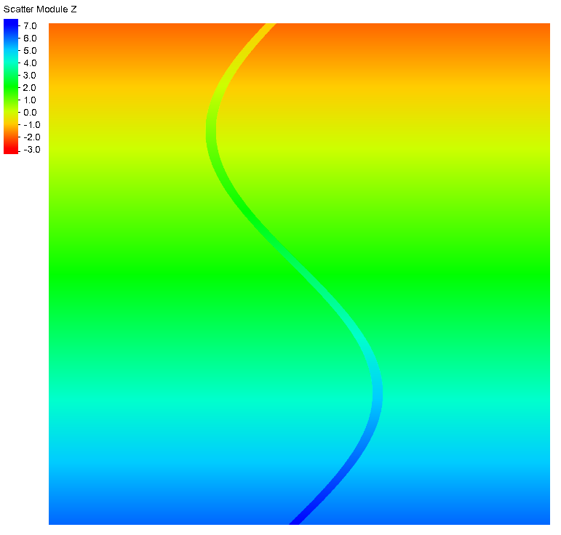
250 m
High resolution (10 m) DEM featuring a 250 m wide winding channel was used to calculate the sub-mesh variables.
12000 m
12000 m

Slide 20
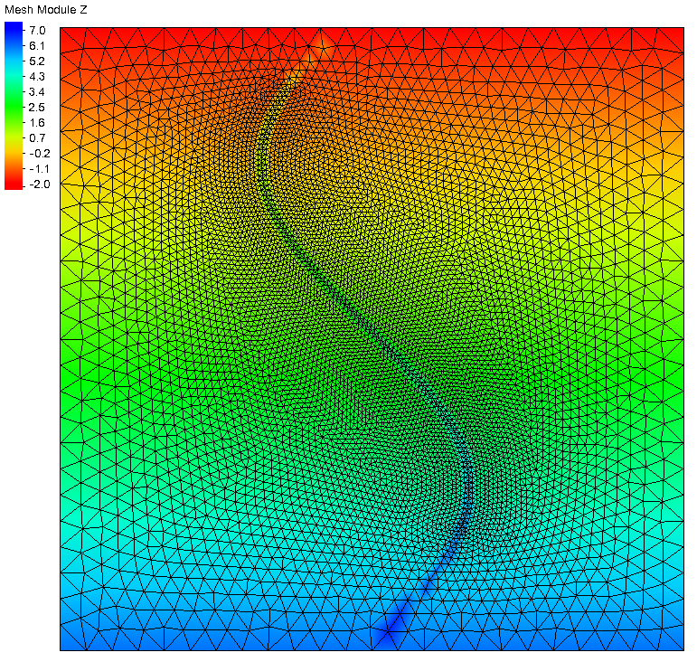
High resolution mesh was created using this DEM.
This mesh resolves the small channel.
12000 m
500 m
Vertices: 6420 Elements: 12742
12000 m

Slide 21
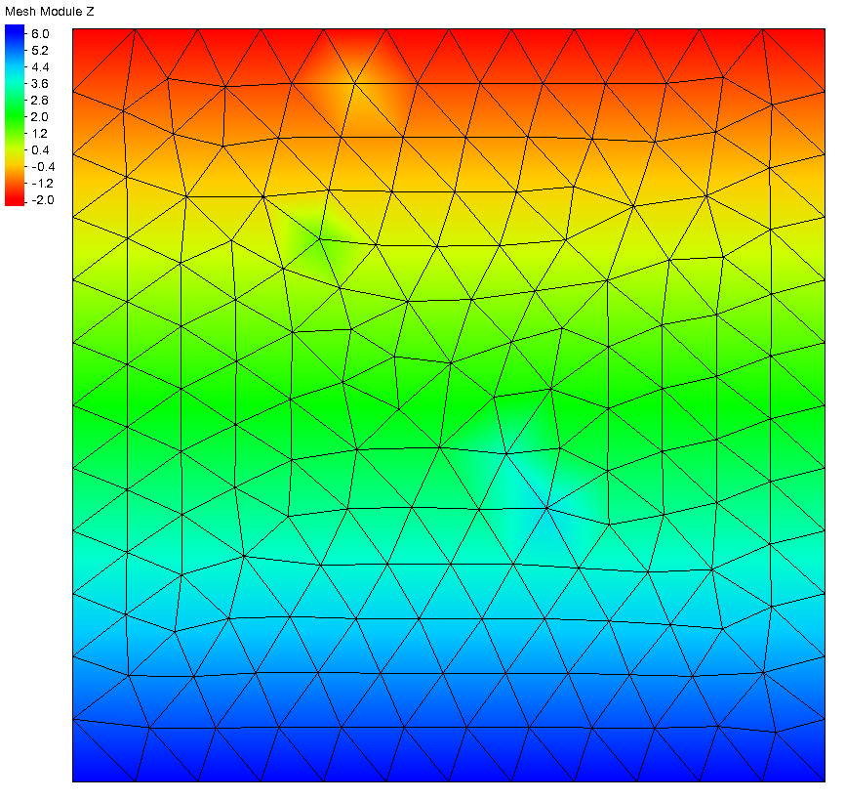
Coarse resolution mesh was created using the DEM.
This mesh was created by simply paving elements over the domain.
12000 m
1000 m
Vertices: 192 Elements: 334
12000 m

Slide 22
High Resolution
Coarse Resolution
Vertices: 6420 Elements: 12742
Vertices: 192 Elements: 334

Slide 23
Water surface elevations were taken from these vertices

Slide 24
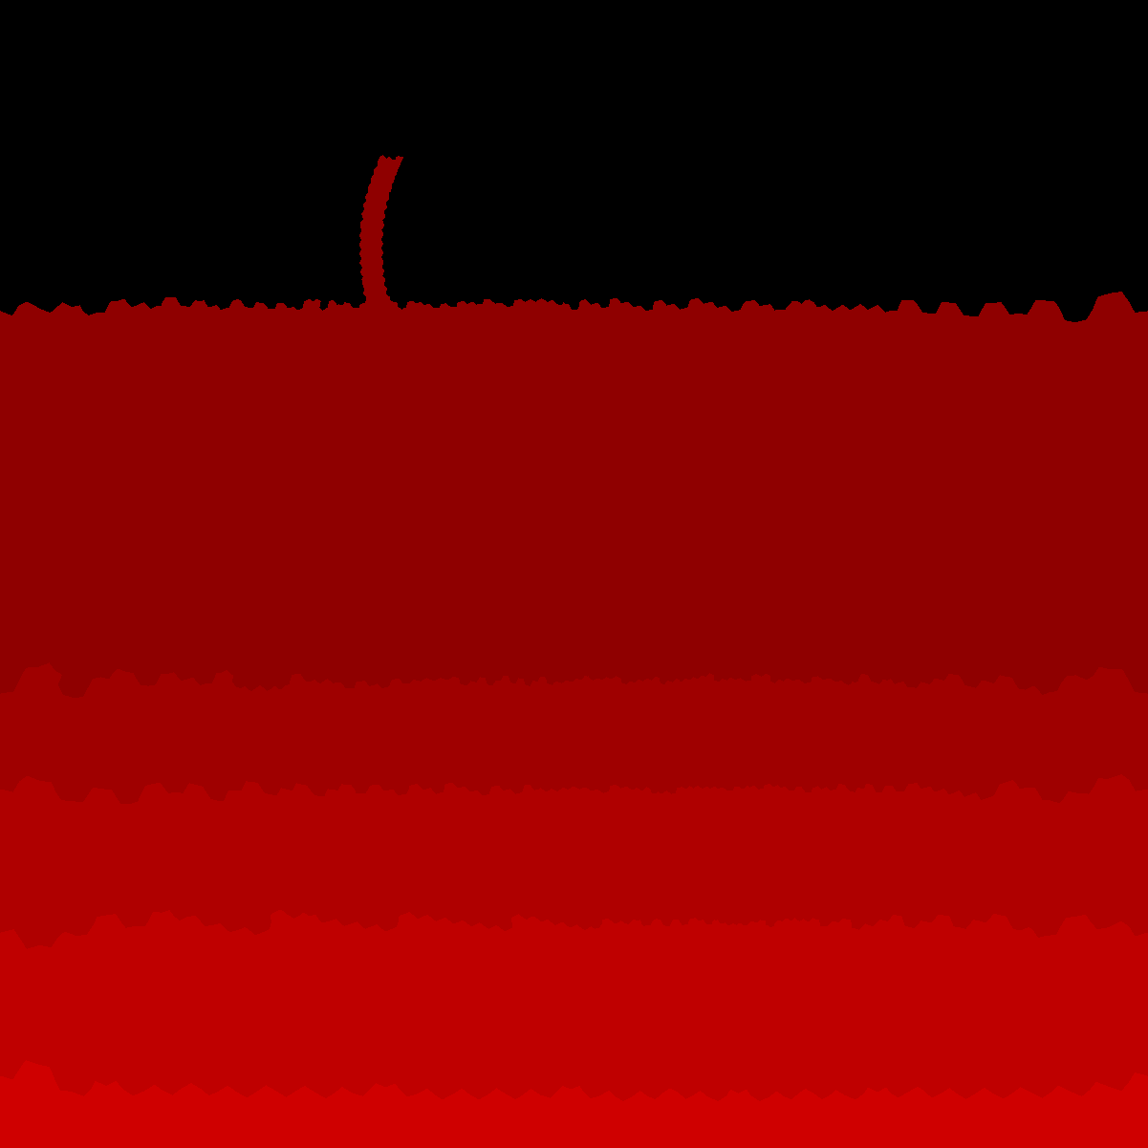
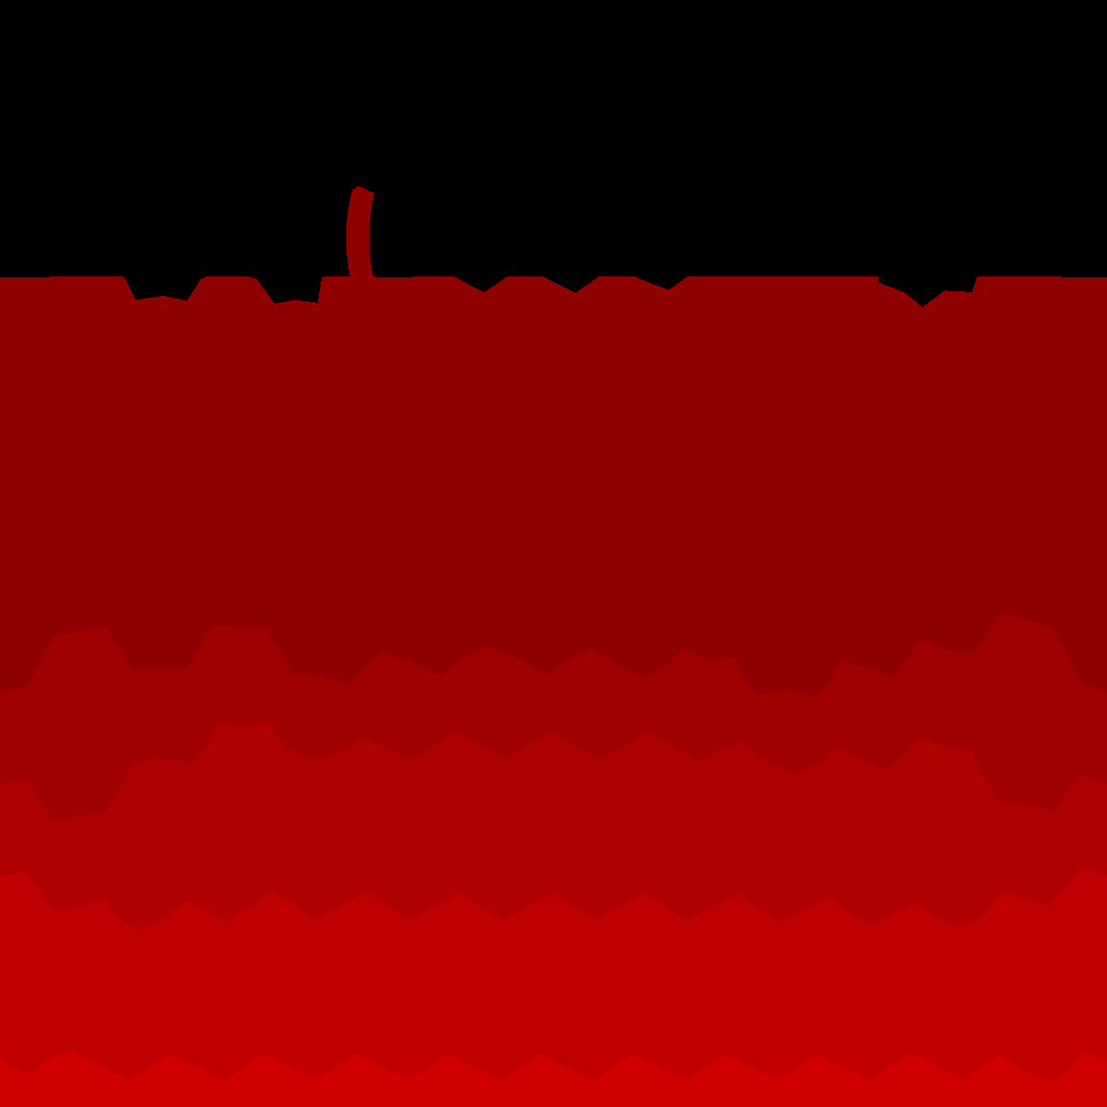
High Resolution
Coarse No SUB-MESH
Coarse SUB-MESH

Slide 25
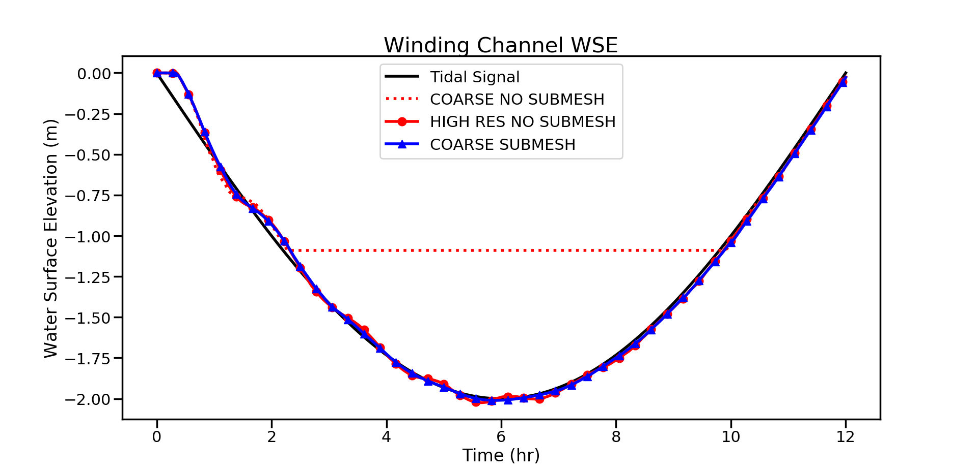

Slide 26
RUN TIMES
High Resolution (no sub-mesh) | 591 seconds
Coarse Resolution (no sub-mesh) | 14.5 seconds
Coarse Resolution (sub-mesh) | 20.75 seconds
The sub-mesh adds roughly 40% to computation time.
This is likely to improve as the code is clean up for use on more realistic test cases.

Slide 27
Conclusion
The sub-mesh code was able to accurately predict water surface elevation on a coarsened mesh.
The computational cost of the sub-mesh model was close to 30 times less than the high resolution traditional run.
Coarse mesh creation was extremely fast and easy compared to creating the high resolution mesh.

Slide 28
Future Work
The wetting and drying routine is still being adjusted to allow for smaller $φ_{dry}$.
A threshold of around 5% would be ideal in the future.
The model is also experiencing stability problems at the top of the domain when running multi-day simulations.
Testing on a realistic domain such as Caernarvon Marsh, LA is soon to come.

Slide 29
Thank you!
Questions?
Thank you to the National Science Foundation for sponsoring this research

