Slide 1
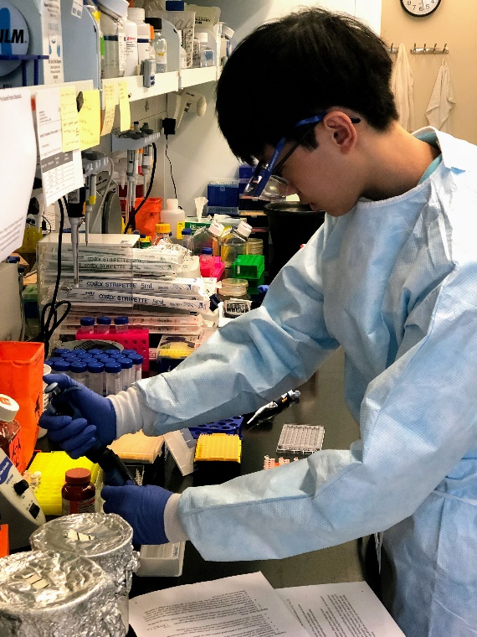
Human Immunodeficiency Virus-1 Reservoir in Human Brain Myeloid Cells
Daniel Zhong
Biostatistics Major, B.S.P.H.
Faculty Advisor: Guochun Jiang
UNC HIV Cure Center, Institute for Global Health and Infectious Diseases

Slide 2
Research Question
Are brain myeloid cells (BrMCs) isolated from people living with HIV (PLWH) latently infected, harboring replication competent HIV in the central nervous system (CNS)?
Purpose
Understand the persistence of HIV in long-lived BrMCs and mechanisms of HIV latency in the CNS.
Document BrMC replication competent HIV by analyzing the pure population of BrMCs isolated from the fresh post-mortem brains of PLWH.
Measure the frequency of inducible replication competent HIV by conducting quantitative viral outgrowth assay (QVOA).

Slide 3
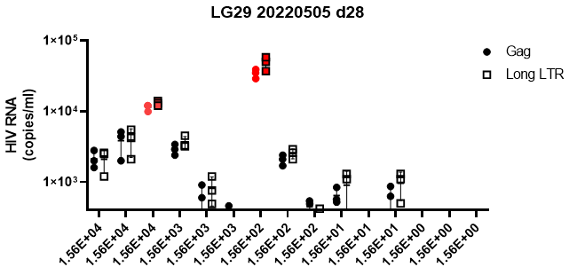
Results
Conclusion
A. The representative interface of digital droplet PCR assay to measure HIV RNA release in the supernatants of BrMC cultures
HIV RNA expression can be induced in patient-derived BrMCs followed by latency reversal when co-cultured with PHA- stimulated PBMC blasts.
The data confirm the existence of replication competent HIV in the BrMCs, which serves as a stable HIV reservoir in the CNS.
Future studies are needed to develop new therapeutic strategies to eradicate HIV reservoirs within the CNS.
HIV RNA positive wells
Negative control wells
B. Detection of HIV RNA release in wells with different amounts of viable BrMCs from antiretroviral therapy-suppressed PLWH by QVOA
Replicate Wells

