Slide 1
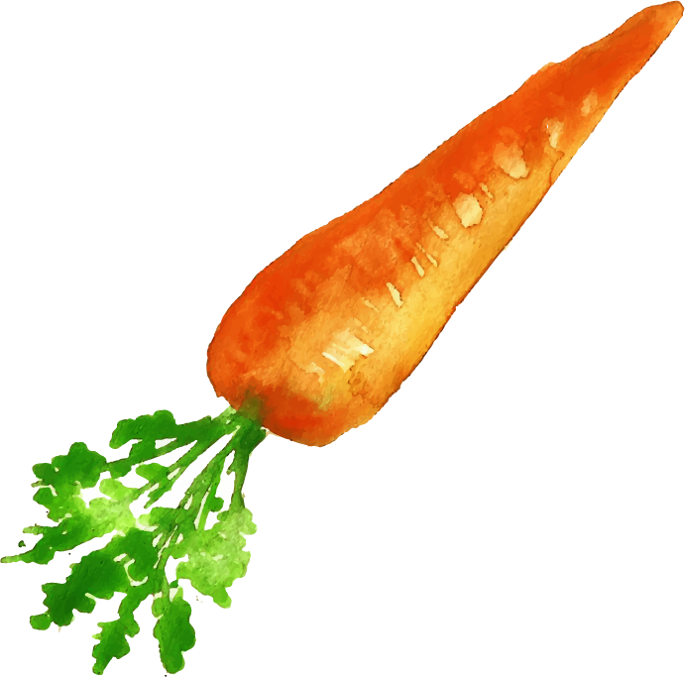
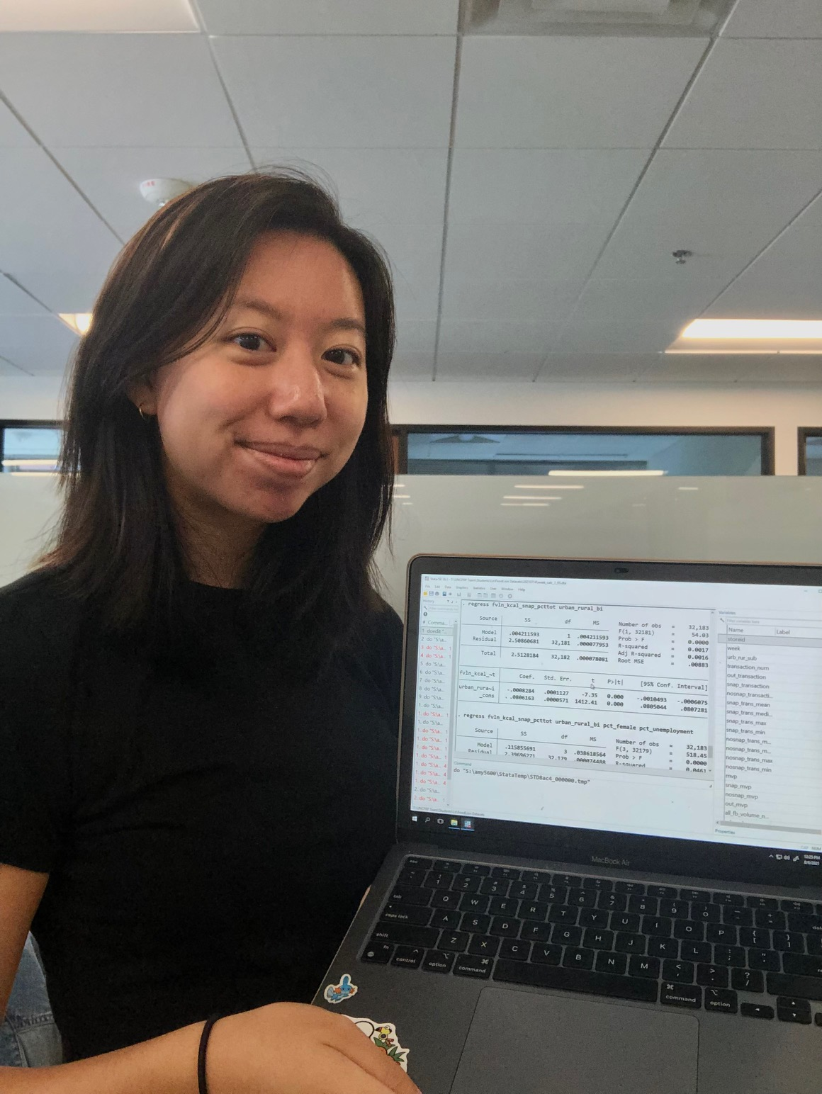
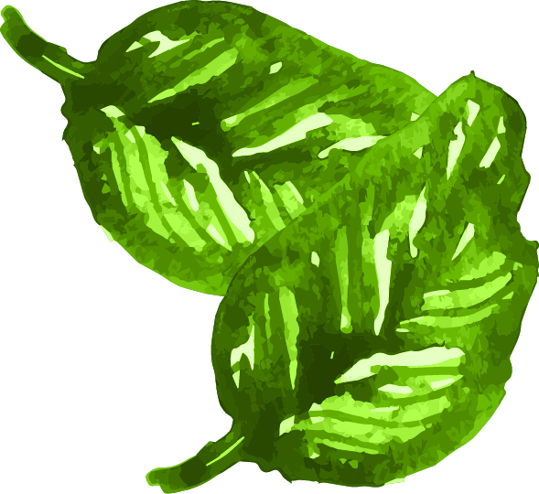
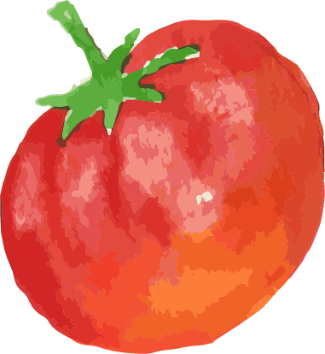
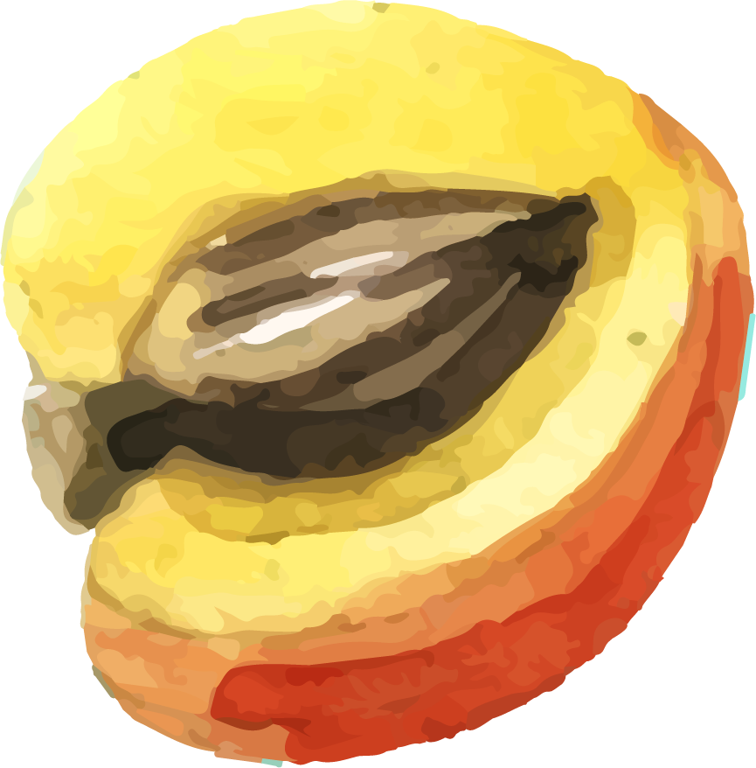
Urban and Rural Purchasing Patterns of SNAP Participants in North Carolina
Amy Lo
UNC Undergraduate Student, Department of Nutrition
Faculty Adviser: Shu Wen Ng, PhD, Department of Nutrition

Slide 2
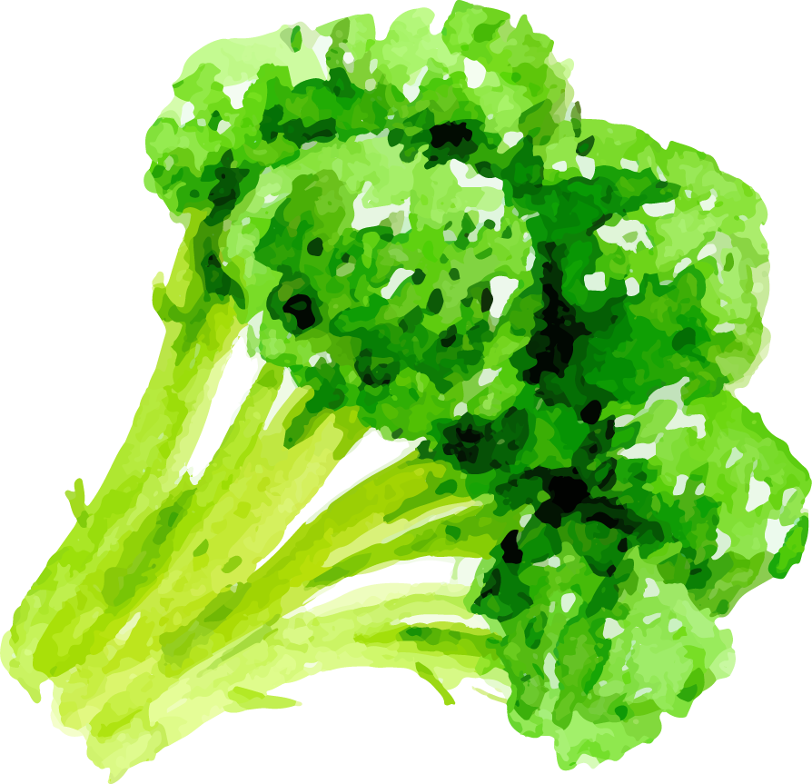
AIMS
Research Question: How do rural and urban NC SNAP purchases differ?How do sociodemographic & food environments affect purchasing?
COVID-19
Compare
Why is it important? Rural food environments tend to be less conducive to healthy diets, but we want to be able to quantify these effects on vulnerable populations.
Food retail policy and future interventions can effectively target the right populations based on evidence from this and other similar studies.
Examine the effects of COVID-19 on any existing disparities between urban and rural food purchases
Compare urban and rural SNAP participant purchases by food category

Slide 3
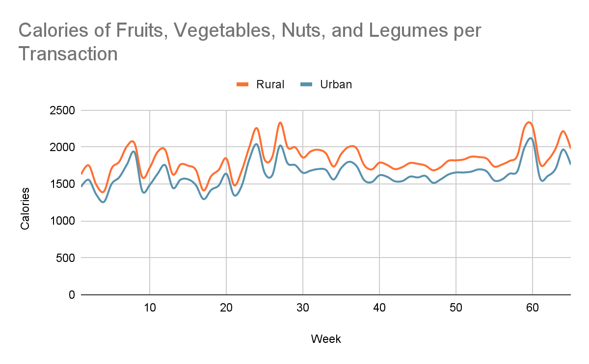
Preliminary Descriptives
Data spans October 2019 to December 2020
North Carolina stores are classified as either rural or urban
We will layer on contextual information in the future - these are not final results
The current literature does not examine subpopulations within the SNAP program. Identifying differences among SNAP participants can better tailor the SNAP program based on location and residence.
SNAP will be more effective in the long run because of research like this (Making better use of taxpayer dollars)
Research on food environments will improve options and access for everyone
March 30th 2020 - NC Stay at Home Order Declared
March 10th 2020 - NC Declares State of Emergency
Next Steps: Conducting analyses with additional contextual data given store locations to understand how the socio-demographics and food environment characteristics might be associated with purchase outcomes. Results to come!

