Slide 1
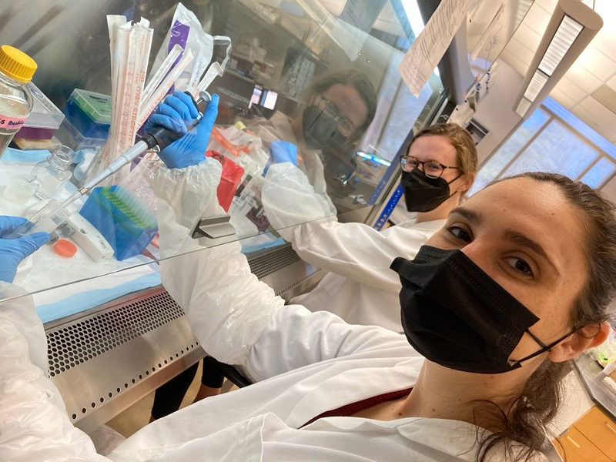
Targeting Inflammation Resolution in Obesity: The Effect Of SPM Supplementation On Immune Function In Individuals With Obesity
Jennifer Regan
B.S.P.H Nutrition
Dr. S. Raza Shaikh, PhD
Department of Nutrition

Slide 2
Project Aims
To assess the effects of supplementation with omega-3 polyunsaturated fatty acid derivatives, known as specialized pro-resolving mediators (SPMs), on the immune function of individuals with obesity
Significance:
Existing research has shown that individuals with obesity exhibit lower levels of SPMs at baseline
Research has also showed that obesity results in impaired immune function
It has been hypothesized that this impaired immunity may be due to excessive inflammation which may be resolved by increasing SPM levels
Therefore, investigating whether supplementation to increase SPM levels in obese individuals helps to resolve excessive inflammation in individuals with obesity is a crucial research area

Slide 3
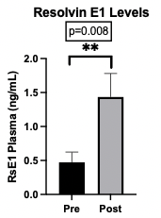
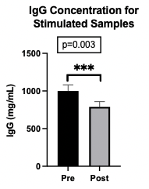
Results
Through analysis of plasma from patients pre- and post- supplementation, the supplement was found to significantly increase levels of circulating specialized pro-resolving mediator (SPM), Resolvin E1 (as seen in Figure 1)
A significant difference was found in patient samples pre- and post-supplementation for samples exposed to substances which simulate infection (see Figure 2) in order to assess immune function pre- and post-supplementation
Antibody levels (IgG), indicative of immune response to simulated infection, were lower on day 14 of cell culture
Figure 1. compares Resolvin E1 plasma levels pre- and post-supplementation
This result indicates that immune function pre- and post-supplementation was significantly increased, as indicated by post-supplement levels of antibodies being lower on day 14 of cell culture
Figure 2. compares antibody (IgG) levels pre- and post-supplementation
These results could indicate that the SPM supplement had the effect of increasing the cells’ ability to resolve the inflammation resulting from the simulated infection

