Slide 1
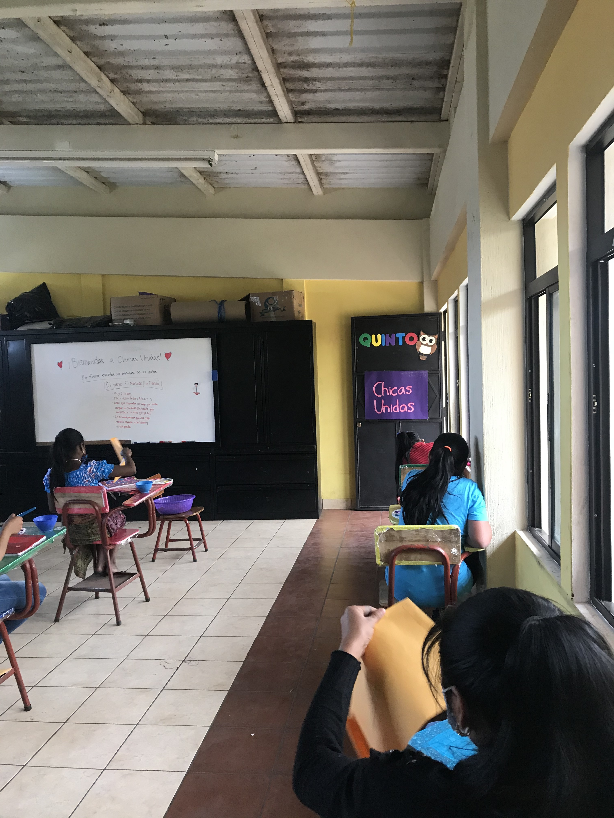
“A multi-faceted approach to sustainable reproductive health education for young girls in Antigua, Guatemala”
Regan Curtis
Hispanic Literatures and Cultures B.A.
Dr. Hélène de Fays, Romance Studies
Notes:
https://our.unc.edu/fund/surf/preparation/

Slide 2
About the research
Research question: What are the current attitudes/beliefs surrounding reproductive health in Guatemala and which methods are most effective for sexual health education?
Why does this research matter?
Sexual health is one of the most relevant yet undertaught subjects in youth education. This project implemented an intervention strategy to teach healthy communication, contraception, and women’s empowerment to girls in Santa Maria, Guatemala while also interviewing community members about their views on these issues. By better understanding local attitudes, we are able to work with Guatemalan organizations in order to serve local communities. The program was planned in cooperation with a local nonprofit, De Casas a Hogares, run by a mix of Guatemalan and American citizens, in order to ensure the program met specific community needs with culture sensitivity. The program, called “Chicas Unidas," taught 25 girls in Escuela Kemna’Oj ages 10 through 17 during an eight week program. We also interviewed 50 local mothers as well all program participants about reproductive health and feedback on the program.

Slide 3
Findings
Results: Findings from this research project can be divided into two categories: local attitudes and program effectiveness. The 50 interviews with local mothers yielded an interesting mix of views regarding reproductive health. While many were in favor of using contraception methods, others viewed birth control as either dangerous to the body or against religious values. Approval of contraception also seemed to positively correlation with the parent’s education level and negatively correlate with age. As for findings on the program itself, feedback from the students was overwhelmingly positive. Most students considered the program helpful and relevant to their life, and highlighted the puberty unit as most important. Students’ views on contraception methods is generally much more positive than that of their parents, showing a generational shift in attitudes towards reproductive health.
Importance to community: I will meet with the director of the nonprofit this fall to review the students’ feedback of the program. These findings are important to the Santa Maria community as he hopes to continue and improve the program in the future. These findings are also relevant to the research community as a whole since similar programs can build on our findings, especially those relating to sexual health in Latin America.
Importance to general audience: It is also important to try to better our understanding of other cultures and belief systems, and the interviews conducted in this research give an intimate view of a community’s way of thinking. Additionally, many of the effective methods used in our reproductive health program could also be applied within the US and other countries to improve schools’ sexual education programs.

