Slide 1
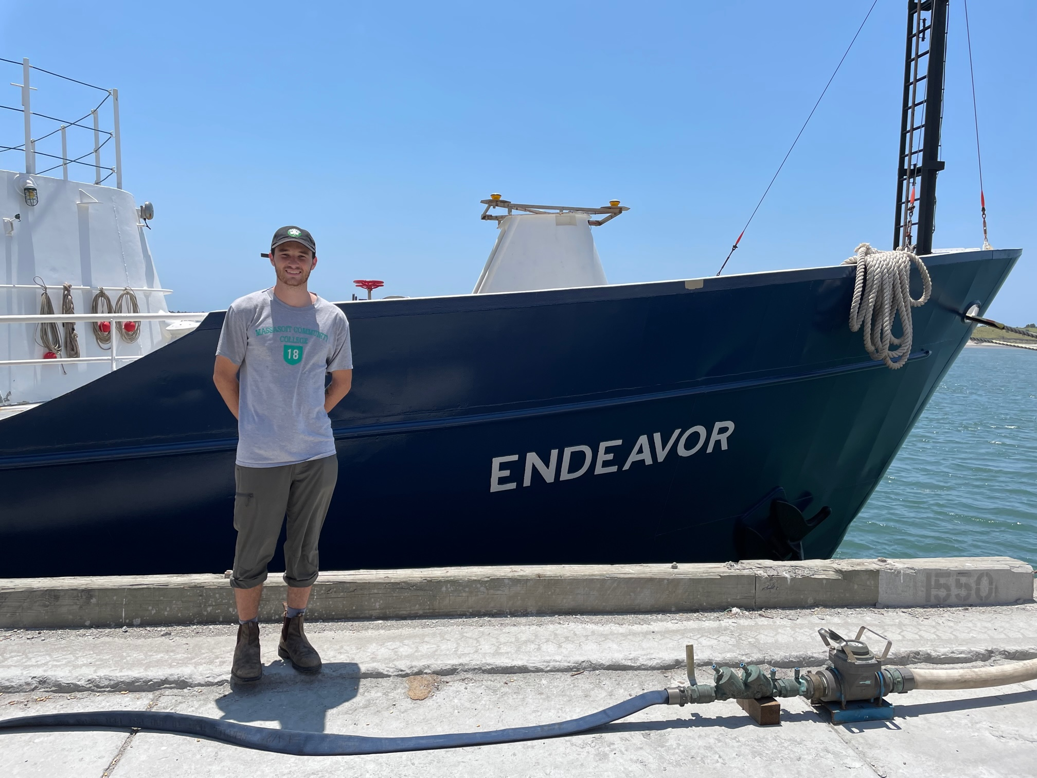
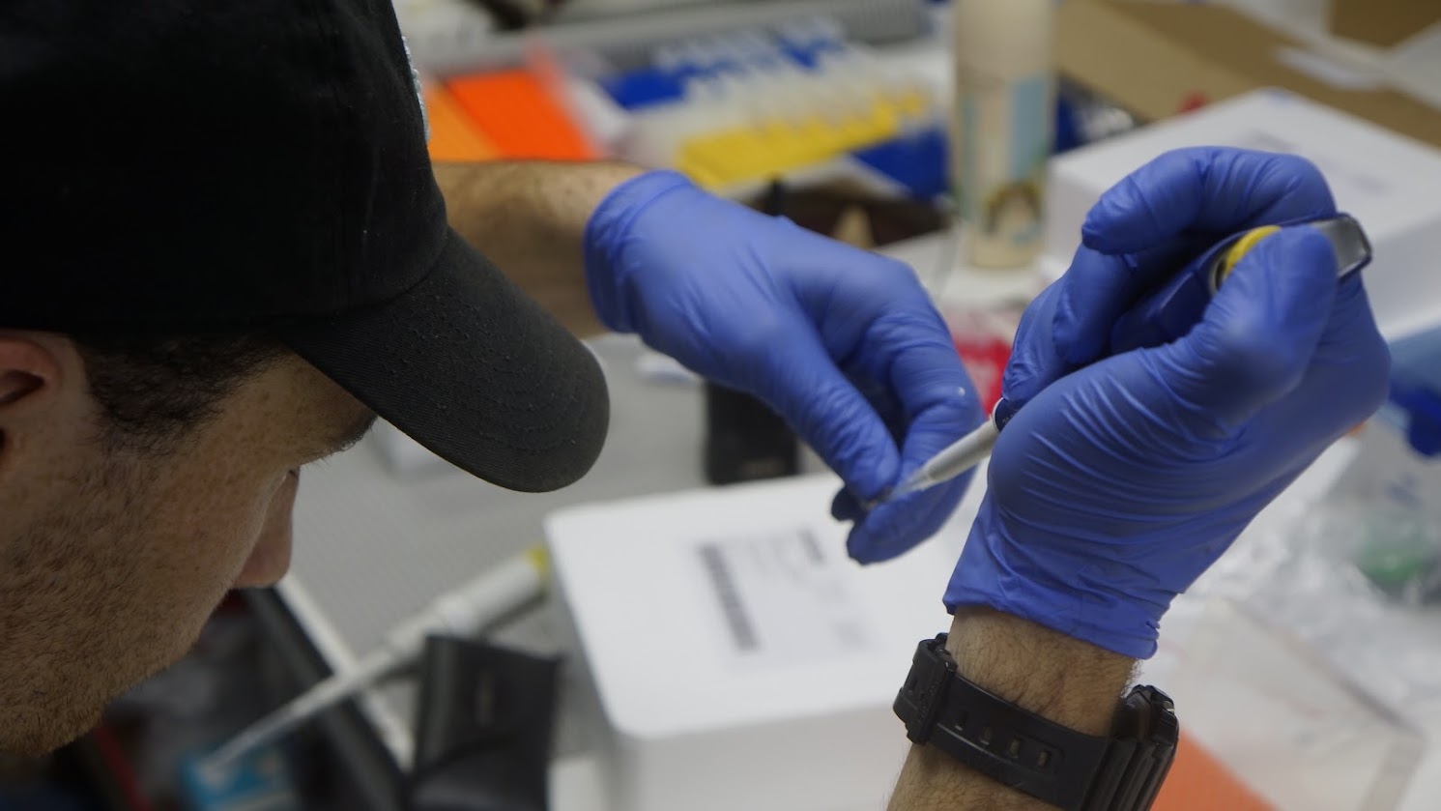
Tracking a key step in the carbon cycle: a new method to detect specific enzyme activities in seawater
Michael DeMaesschalck
Advisor: Carol Arnosti,
Department: Earth, Marine and Environmental Sciences

Slide 2
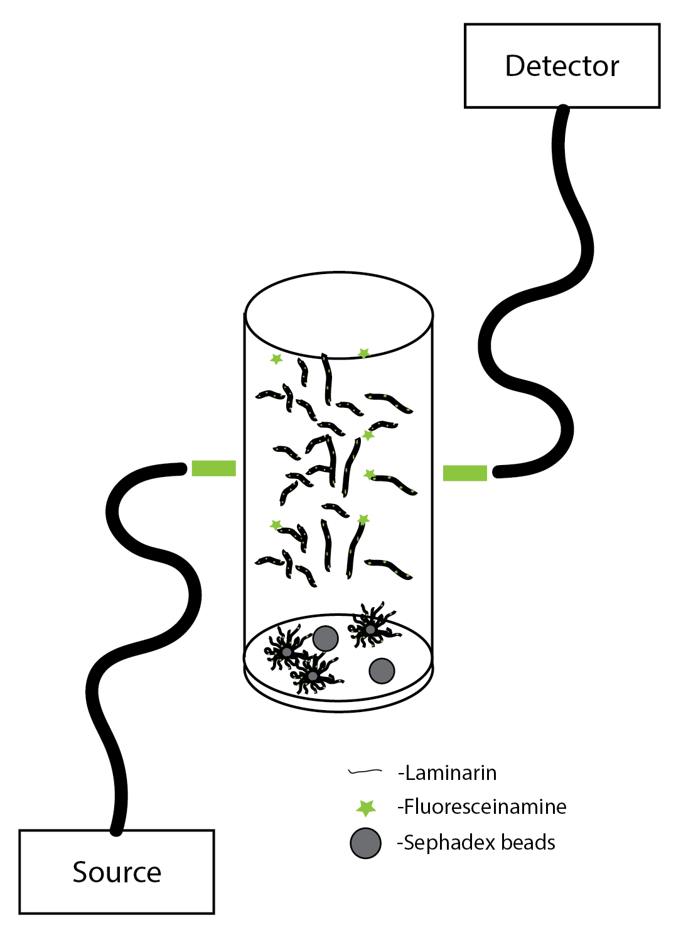
Can a method be developed to rapidly detect the activities of bacterially-derived extracellular enzymes at sea?
Current methods are time intensive and require analysis post-cruise
Rely on creating in situ conditions for measurements
Developed a method (schematic on right) to test hydrolysis of polysaccharides (i.e., Laminarin) from laminarin-linked beads

Slide 3
Tested at 15 stations in Western North Atlantic​
9 stations showed activity within 96 hours ​
6 stations showed activity within 48 hours ​
5 stations did not show any biological activity, suggesting there was no laminarin activity present, or it took longer to occur than the time our incubations occurred​
Meaning of results:
Rapid detection of bacterial enzymatic activity while at sea is possible ​
Can reduce overall sampling time if used as a diagnostic tool to determine enzymes present ​
Method can be optimized for other at sea applications such as pressure studies ​
Provide public with accurate oceanographic research within a shorter period. ​
Fig 1. Data collected from fluorescently labeled laminarin beads incubated in either live or autoclaved (kill control; KC) surface seawater. Fluorescent intensity of overlying water was measured at 0 hours, 24 hours, and 48 hours using a mini fluorimeter.

