Slide 1
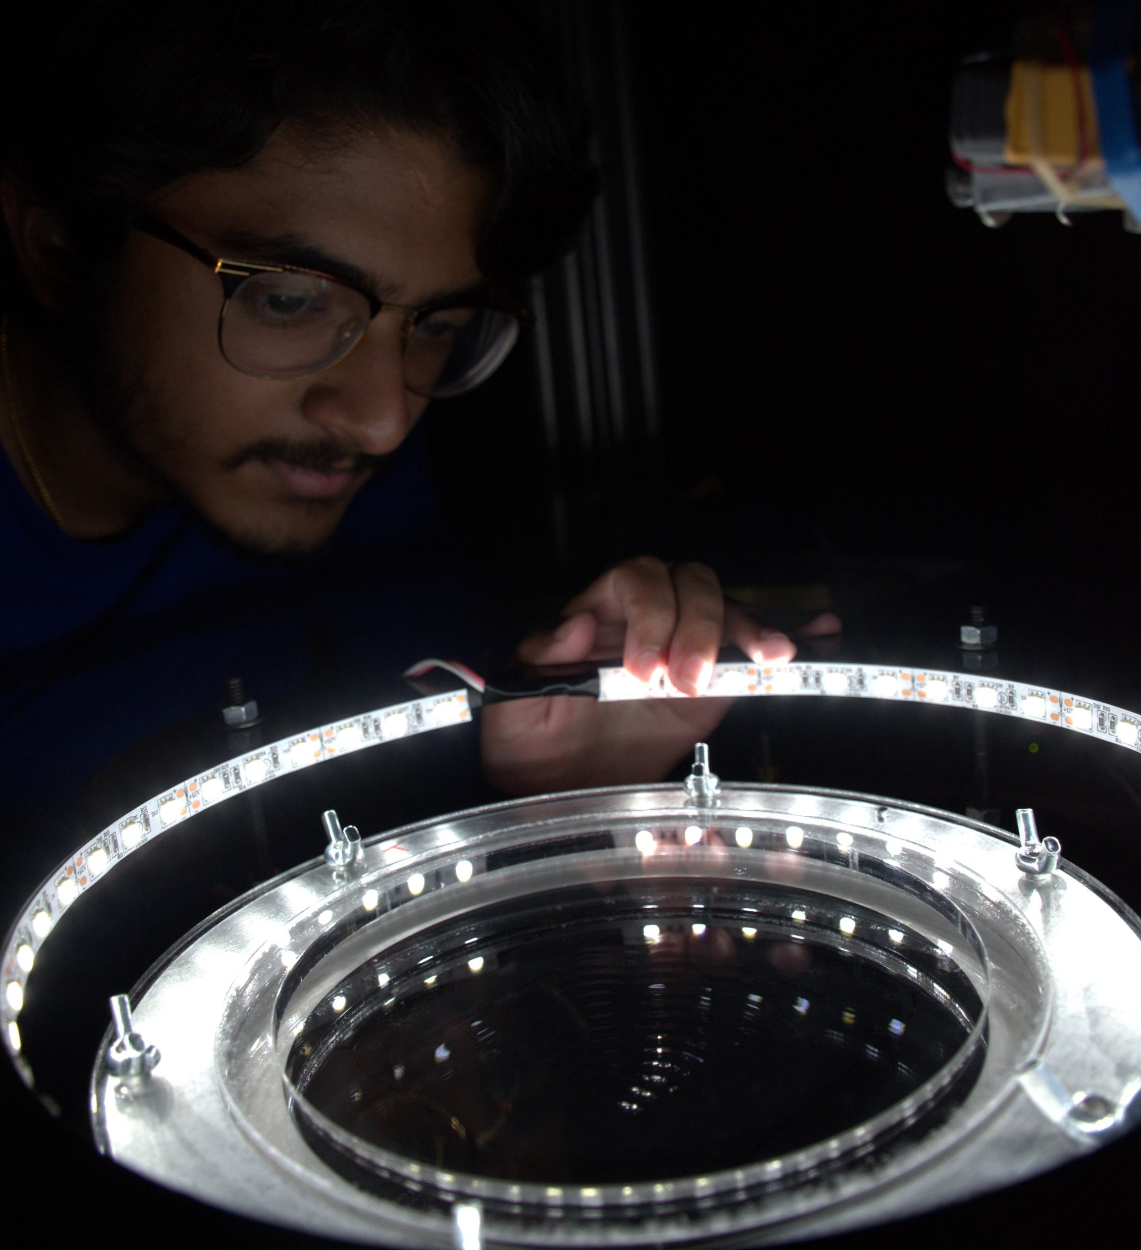
Exotic Diffusion of Walking Droplets
Abel Abraham Mathematics & Biomedical Engineering
Advisor: Professor Pedro J. Sáenz
Mathematics

Slide 2
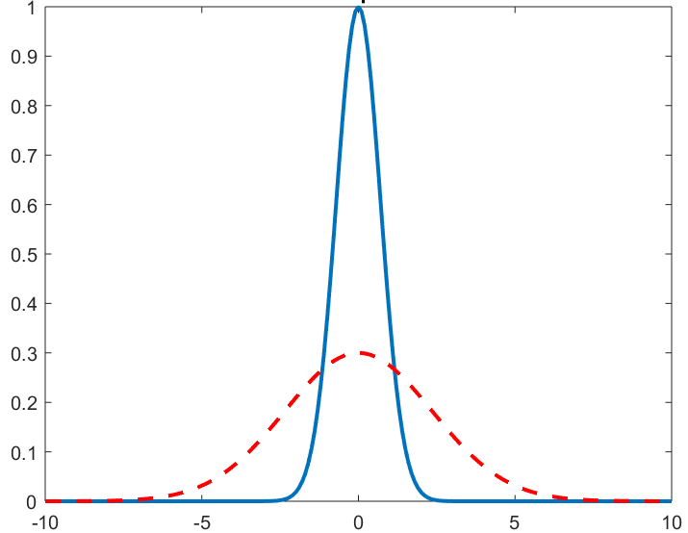
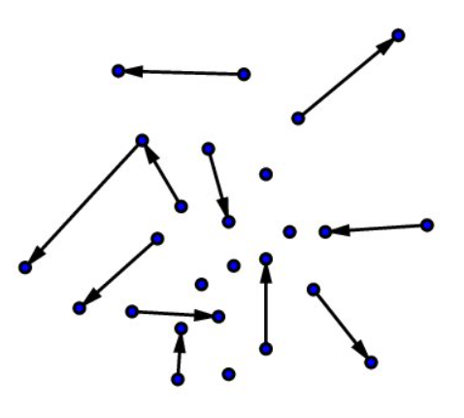
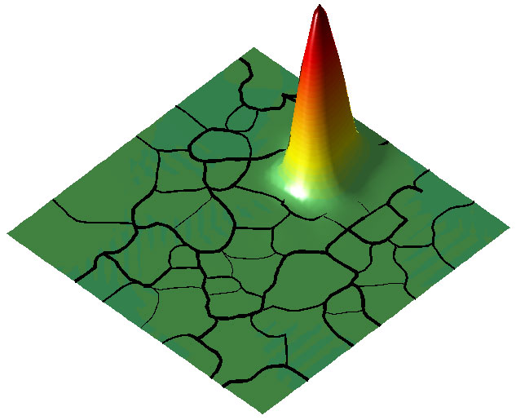
Classical Diffusion
Haque, 2015
Time = 0
Time = 0
Particle Concentration
Time > 0
Time = 0
Time > 0
Time > 0
Diffusive particles “bounce” off random obstacles
A collection of these particles will…
Quantum “Diffusion”
spread out over time
Anderson Localization
Time = 0
Electron stuck
Time > 0
Sometimes electrons don’t spread out and get stuck, or ‘localize’, which is very unexpected
Time > 0
Filoche and Mayboroda, 2012
Quantum particles are also waves and move differently
Can classical particles localize?
So far, this is thought to be impossible

Slide 3
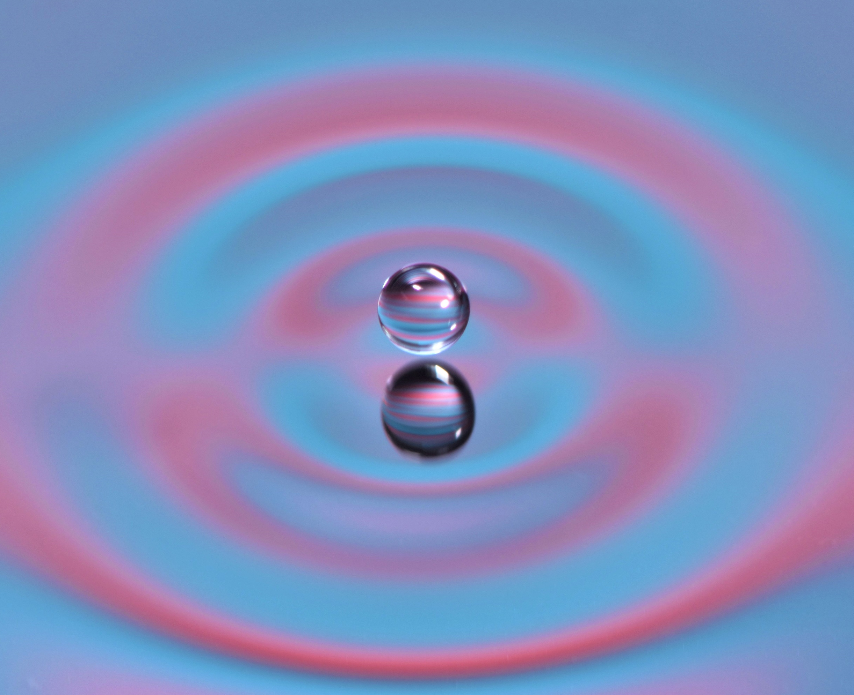
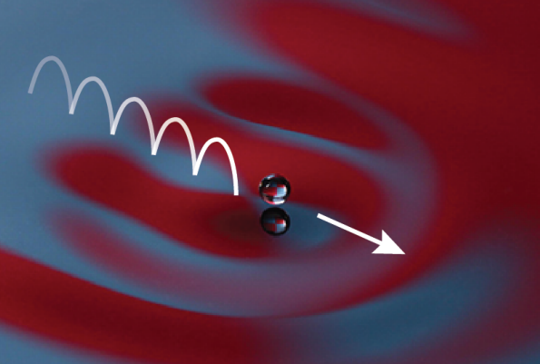
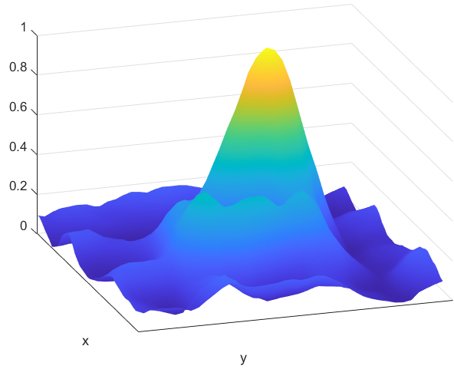
What about a particle guided by a wave?
They may also walk propelled by the waves they generate on impact
Walking droplets bounce on a
vibrating fluid bath
Dan Harris
Droplet Position Histogram
By studying the motion of walking droplets over a submerged topography we show that…
walking droplets can localize like quantum particles!!!

