Slide 1
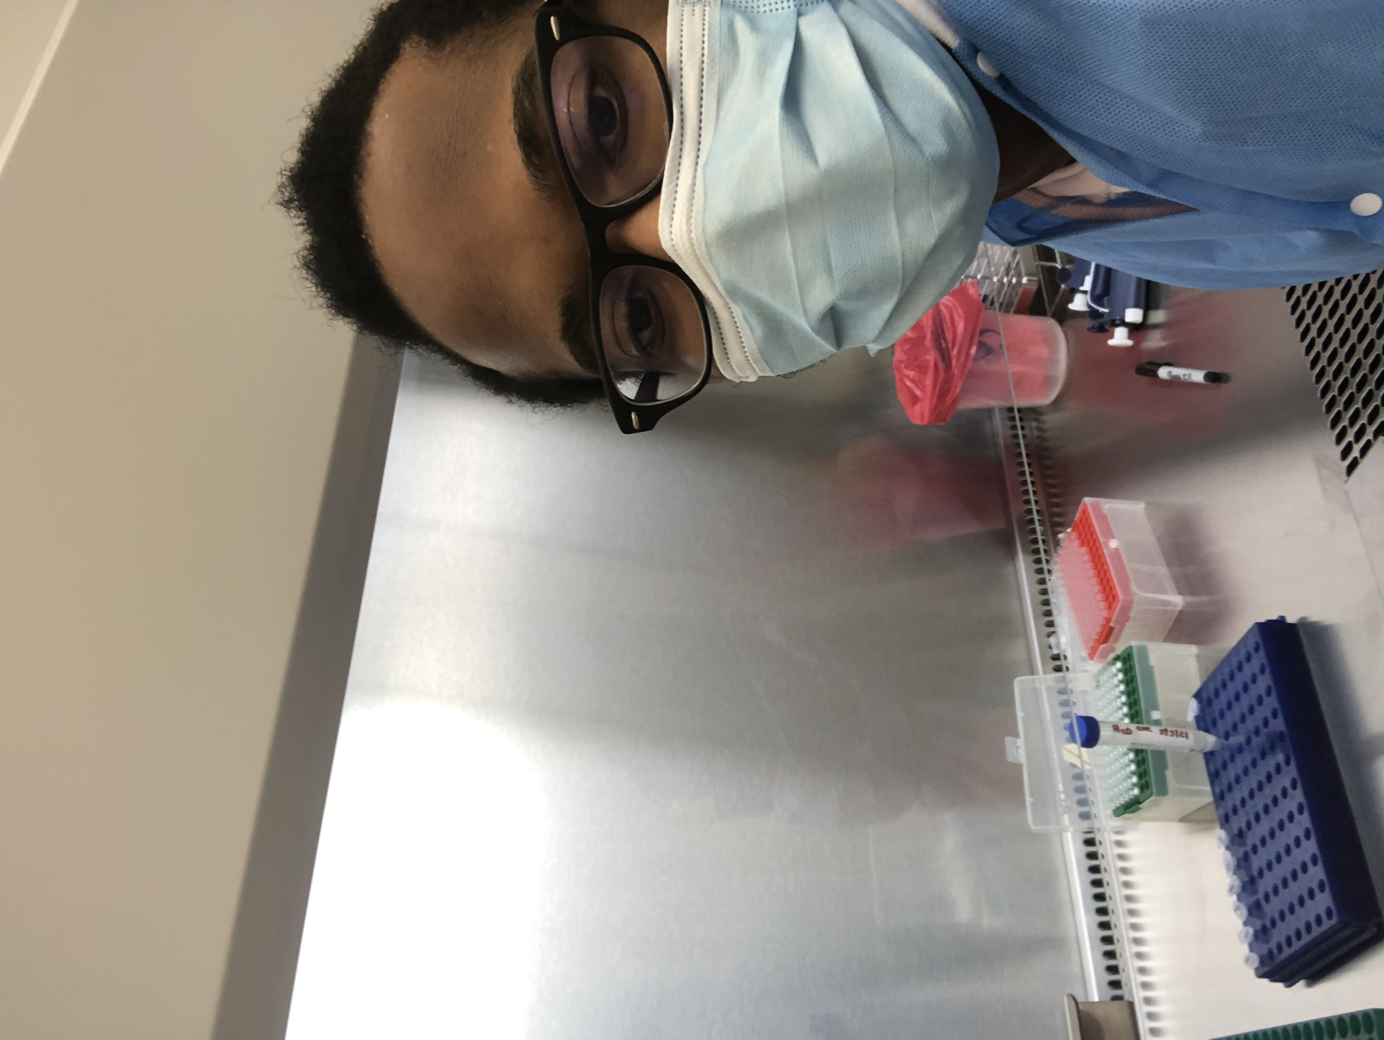
Development of a Point of Care Diagnostic Tool for Human Brucellosis
Name: Osahon Iyamu
Majors: Neuroscience B.S. and Chemistry B.A.
Faculty Advisor: Dr. Jonathan Juliano MD, MSPH
School of Medicine

Slide 2
Research Question
What’s the best way to solve the issues that come with diagnosing Brucellosis, a bacterial infectious disease?
This is important because Brucellosis is endemic in several regions around the world
Being able to diagnose and treat Brucellosis effectively could diminish some of the economic and social impacts caused by Brucellosis across the world.

Slide 3
Research Results
Developed a new, cost-effective way that Brucellosis is diagnosed.
These results are important for the scientific community because the diagnostic tool can be validated in endemic regions
These successful results show us that this same diagnostic tool may be optimized for diagnosing illnesses which are expensive or impractical in many clinical contexts

