Slide 1
Wind Effects on the Choctawhatchee River Plume at Destin Inlet, Florida
Rosemary Cyriac¹, Casey Dietrich¹, Arash Fathi², Clint Dawson², Kendra Dresback³, Cheryl Ann Blain⁴, Matthew Bilskie⁵, Scott Hagen⁵, Hans Graber⁶
¹North Carolina State University, ²University of Texas at Austin, ³University of Oklahoma, ⁴Naval Research Laboratory, ⁵Louisiana State University, ⁶University of Miami

Slide 2
ADCIRC 301

Slide 3
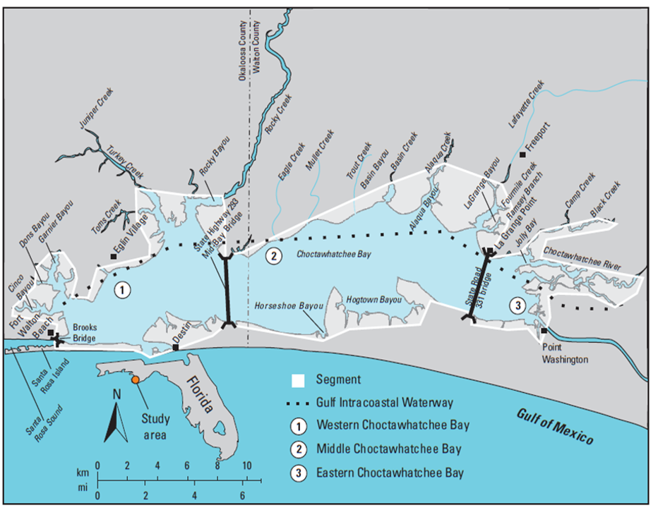
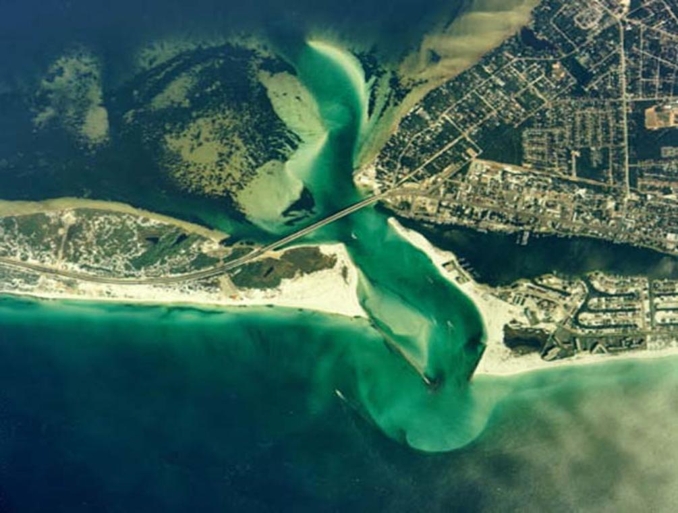
Study Area

Slide 4
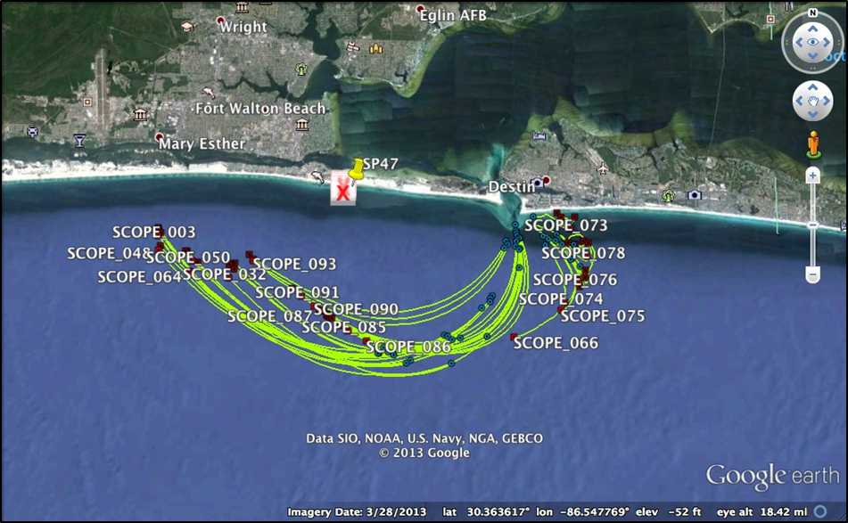
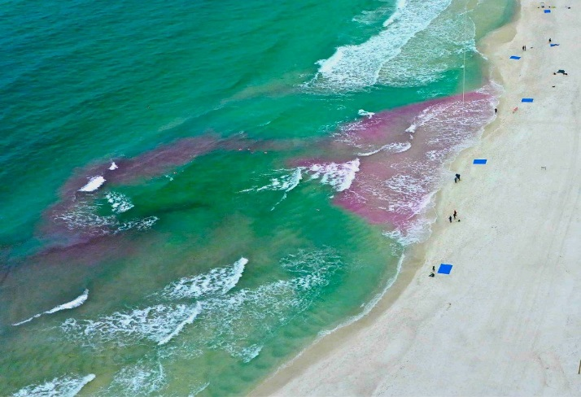
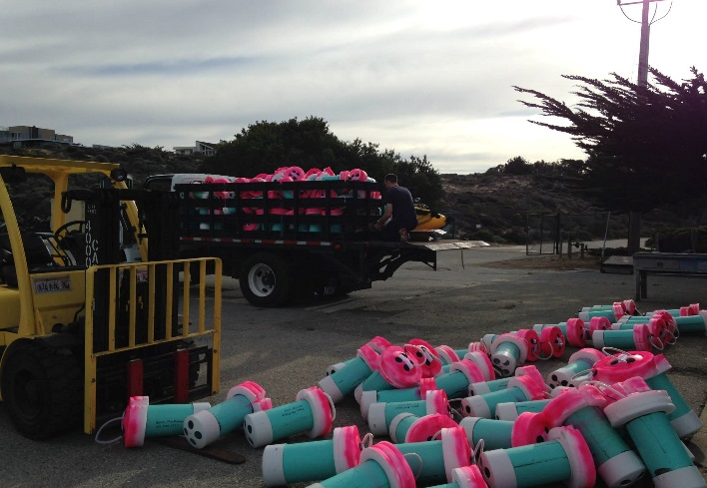
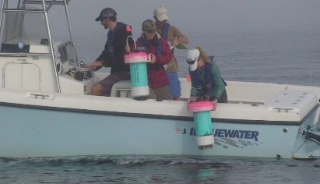
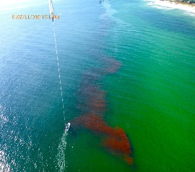
Surfzone Coastal Oil Pathways Experiment (SCOPE)
To understand the processes that are important for surface transport, both for oil spills and other pollutants, as well as for natural materials.
Performed by CARTHE scientists between December 3-17, 2013
With the help of:
Surface drifters
Dye Releases
Drones
Jetskis
Small boats
Helicopters
ADCPs
CTD casts
Source: CARTHE Facebook page

Slide 5
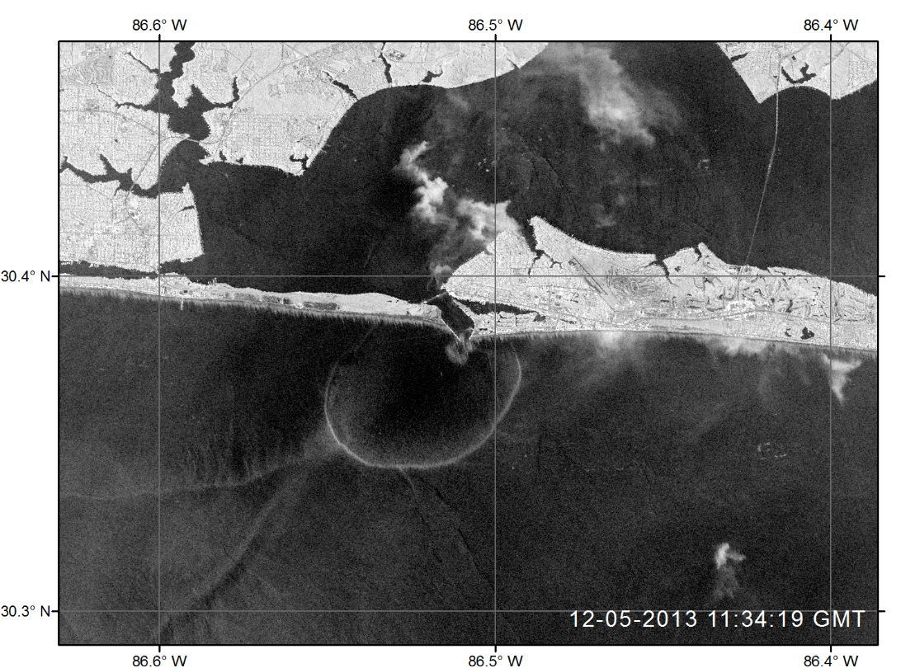
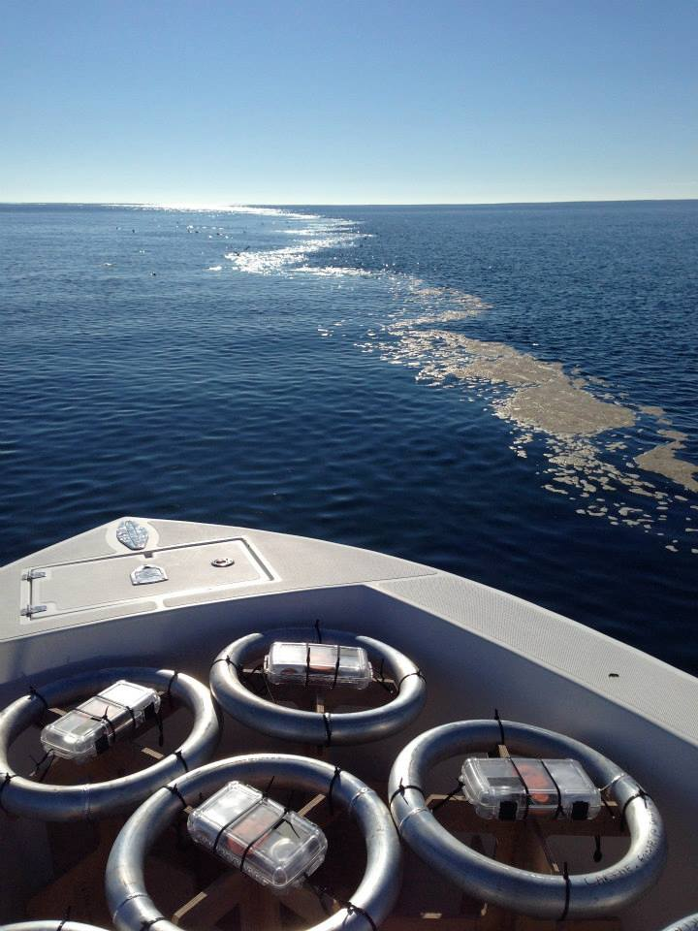
Brackish Plume at Destin Inlet
Source: COSMO-SkyMedâ¢ Product Â©ASI 2013 processed under license from ASI â Agenzia Spaziale Italiana. All rights reserved. Distributed by e-GEOS. Downlinked and processed by CSTARS.
Freshwater river discharge that enters an estuary can flow out into the coastal ocean as brackish, buoyant plumes
Surface material slows down and converges along the plume edges due to the density differences across the plume front
SCOPE datasets recorded the presence of a distinct ebb-phase plume at Destin Inlet

Slide 6
Research Hypothesis
Ebb-phase plume signature at Destin Inlet exhibits variability as wind forcing changes during the passage of cold fronts
Observed during SCOPE experiments in December 2013
Variability in plume signature has implications for the transport of surface material such as chemical and oil pollutants and biological material
Research Objectives
Develop and validate a three dimensional baroclinic model to represent the tide, wind and plume driven circulation in the Choctawhatchee Bay and adjacent shelf waters
Quantify plume response during the passage of winter cold fronts over the study area
Notes:
Add something about what we know from field experiments during CARTHE?

Slide 7
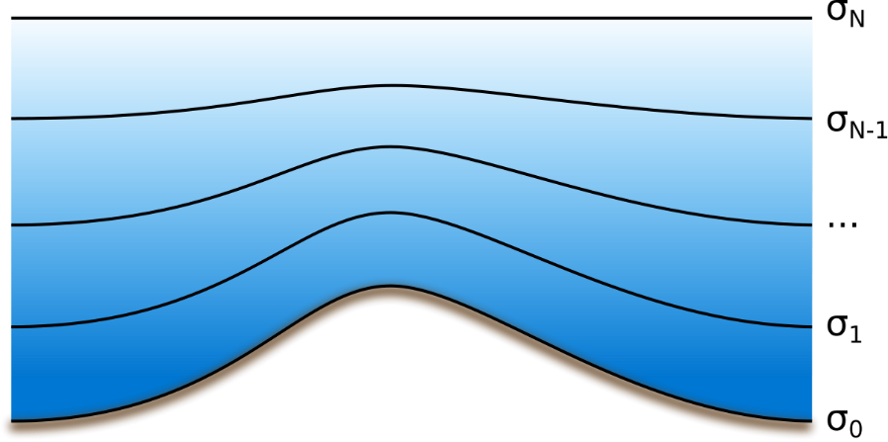
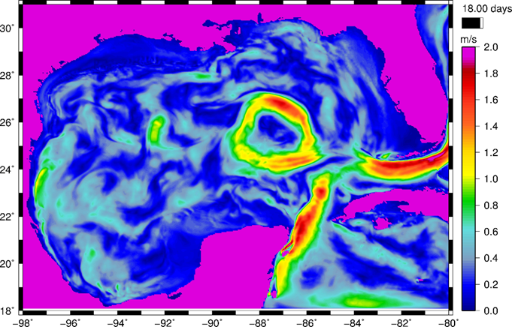
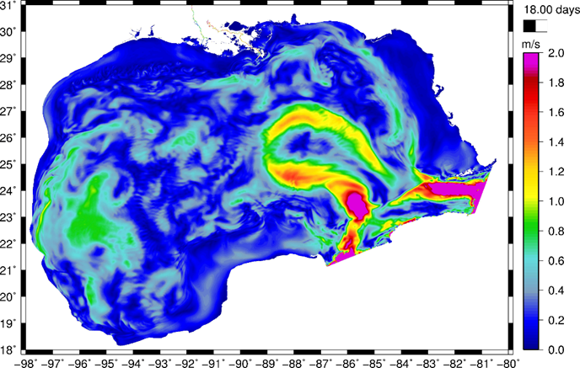
ADCIRC 3D Baroclinic
GWCE (ζ)
3D Shallow Water Equations (u,v,w)
Advection-Diffusion Equation
(Salinity and Temperature)
Equation of State (Density)
σ = 1
σ = -1
Terrain following sigma co-ordinates in the vertical
Recent Improvements to ADCIRC 3D by Dr. Arash Fathi
Sea surface velocities in the Gulf of Mexico
HYCOM
ADCIRC

Slide 8
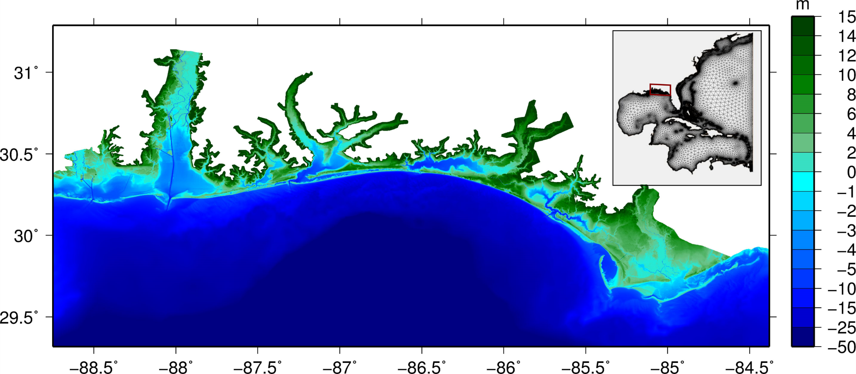
Mesh Development
Perdido Bay
Choctawhatchee Bay
Mobile Bay
Pensacola
Apalachicola Bay
Source : S. Hagen , A. Daranpob, P. Bacopoulos, S. Medeiros, M. Bilskie, D. Coggin, M. Salisbury, J. Atkinson and H. Roberts. Storm Surge Modeling for FEMA Flood Map Modernization for the Northwest Florida and Alabama Coast, Digital Elevation Model and Finite Element Mesh Development. Prepared for the Northwest Florida Water Management District and the FEMA, 2011.
Notes:
Update figure

Slide 9
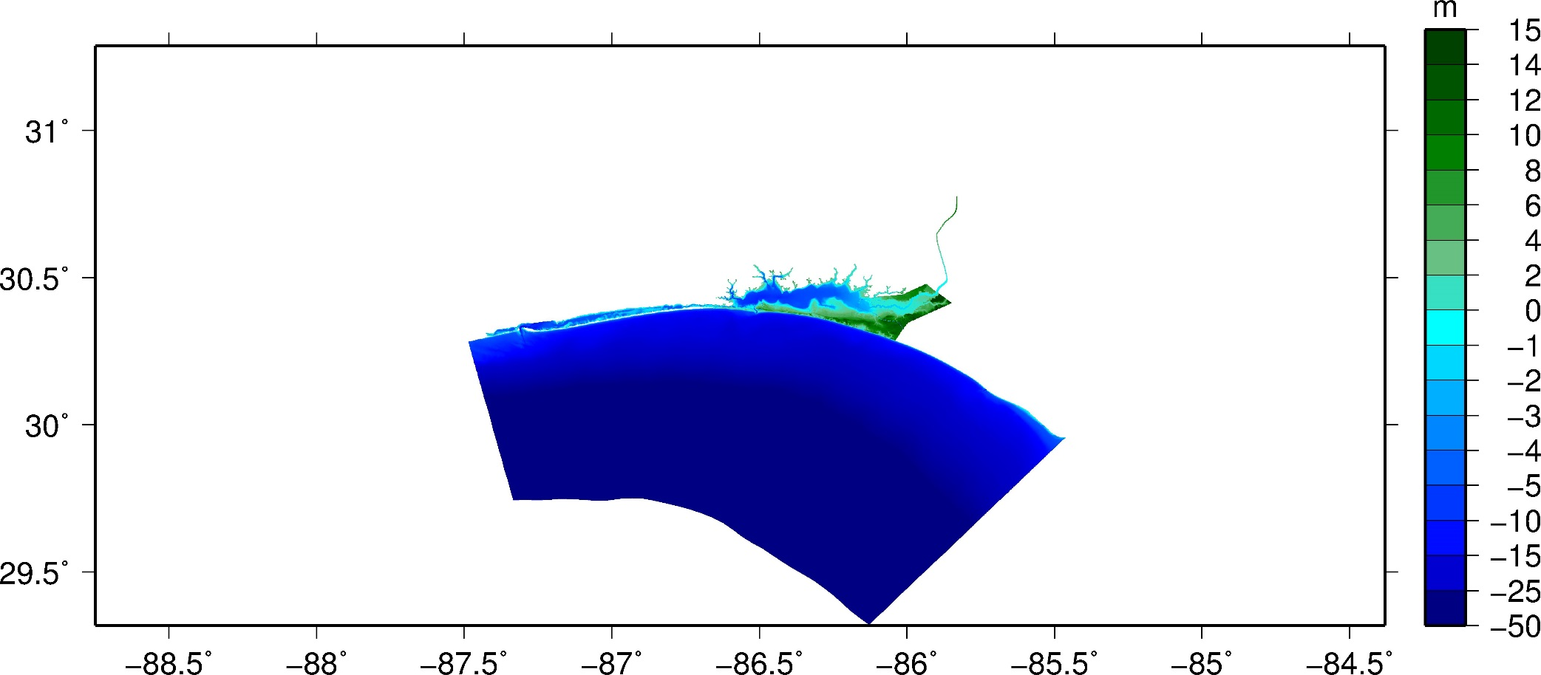
Mesh Development
Choctawhatchee Bay
Mobile Bay
Apalachicola Bay
Resolving Choctawhatchee River
Bathymetry Smoothing above 15m
Increasing offshore resolution
Inlet Refinement
Shelf-scale mesh
Ocean boundary at 200m contour
Notes:
Update figure

Slide 10
Model Set-up
Simulation Period
Diagnostic phase : November 1-5
Prognostic phase : November 5 – December 15
Initial and Boundary Conditions
Tides
Vertical Salinities and Temperatures
Inside Bay – Measurements taken by Choctawhatchee Basin Alliance group
Offshore – Interpolated from publicly archived HYCOM data (HYCOM + NCODA Southeast United States 1/25 Degree Analysis/GOMl0.04/expt_31.0/2013)
Upstream River Boundary is forced with a discharge of 200 m³/s
Surface Heat Flux over model domain
Others
11 uniform vertical layers
Time step = 0.5 s
Total simulation time is roughly 5 days on 3840 cores at the Texas Advanced Computing Center's Stampede 2 systems

Slide 11
Results: Surface Salinities

Slide 12
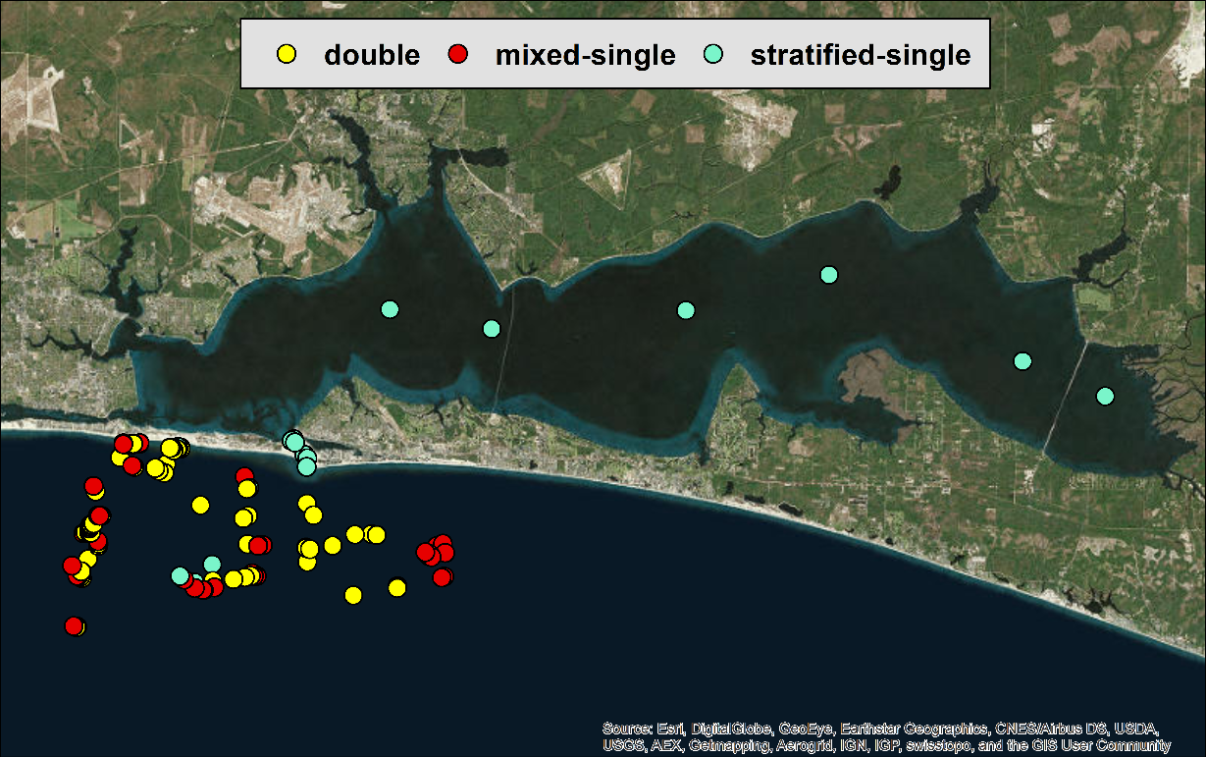
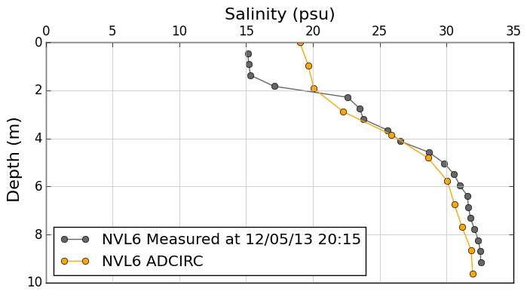
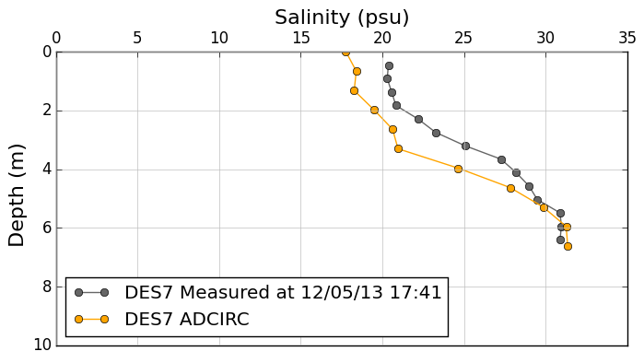
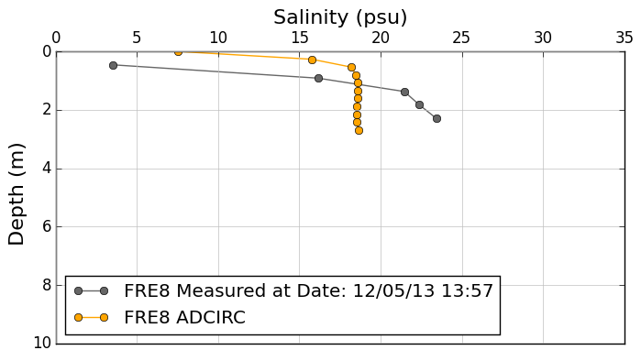
Model Validation: CTD Profiles

Slide 13
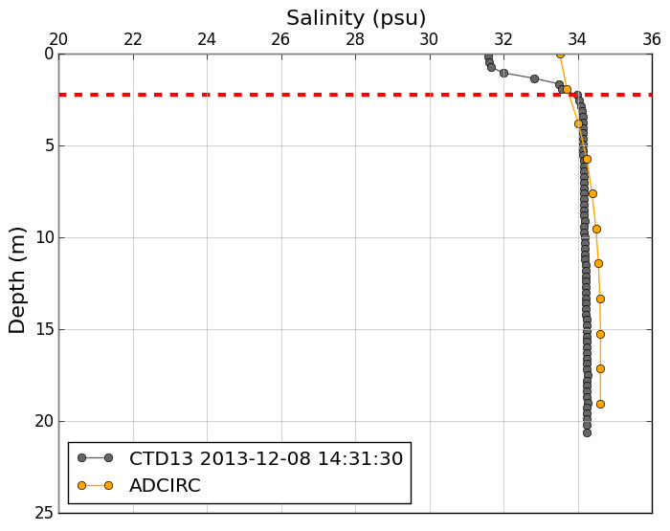
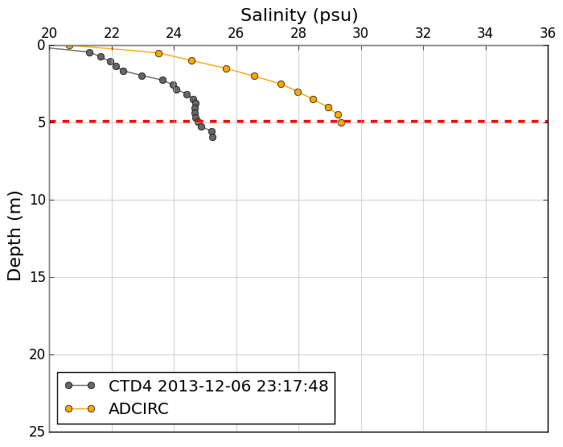
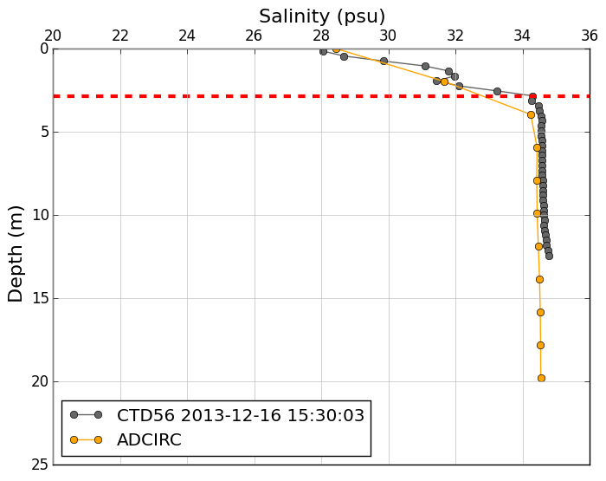
Model Validation: CTD Profiles

Slide 14
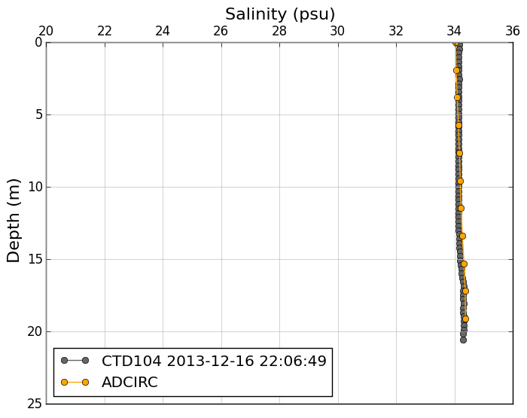
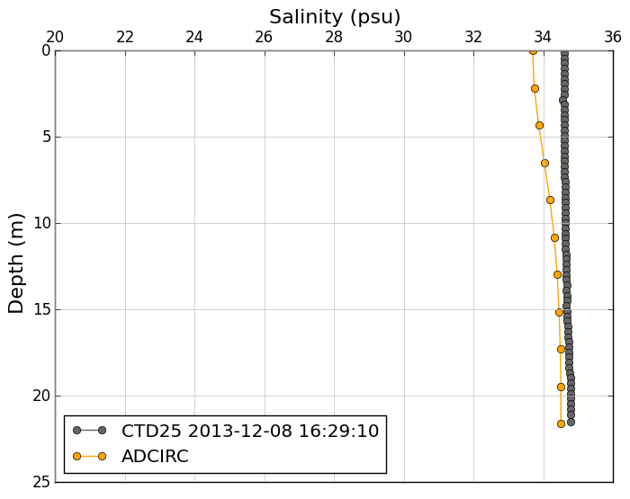
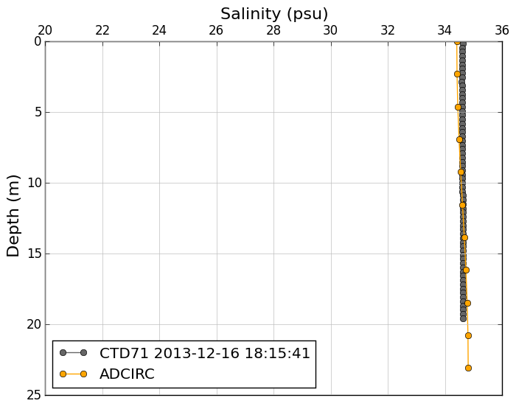
Model Validation: CTD Profiles

Slide 15
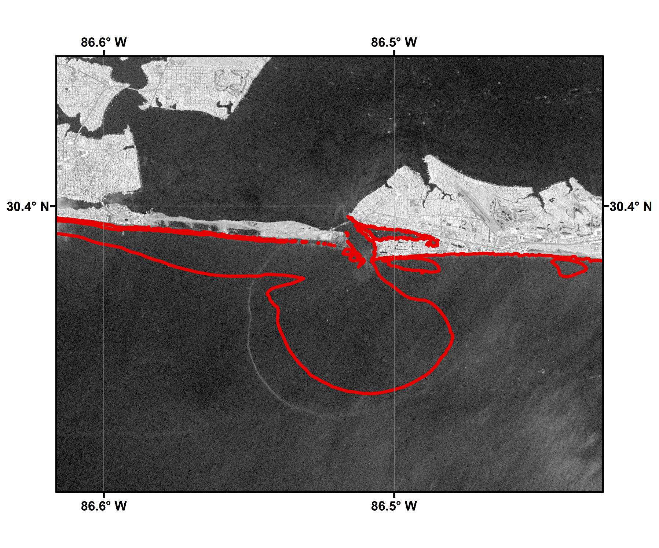
Model Validation: Satellite Imagery
12– 03–2013 11:40:21 GMT
33 psu
Source: COSMO-SkyMedâ¢ Product Â©ASI 2013 processed under license from ASI â Agenzia Spaziale Italiana. All rights reserved. Distributed by e-GEOS. Downlinked and processed by CSTARS.
Notes:
Model salinities are shown by the red line – it corresponds to the 33 psu contour, which is selected to demarcate the plume extents
Following approach in literature used for Perdido Bay (Xie et al. 2011)
Timing of the model results and satellite imagery do not match exactly (ADCIRC salinities are plotted at the end of the ebb phase, which is a few hours after time stamp shown in the satellite imagery (I will revise the figures so that they match exactly and send updated ppt)
Overall, modeled and observed plume extents are very close – establishing confidence in the model’s ability to capture plume signature
- Allows us to do further scenario testing with model results to answer questions about what causes plume variability and how much

Slide 16
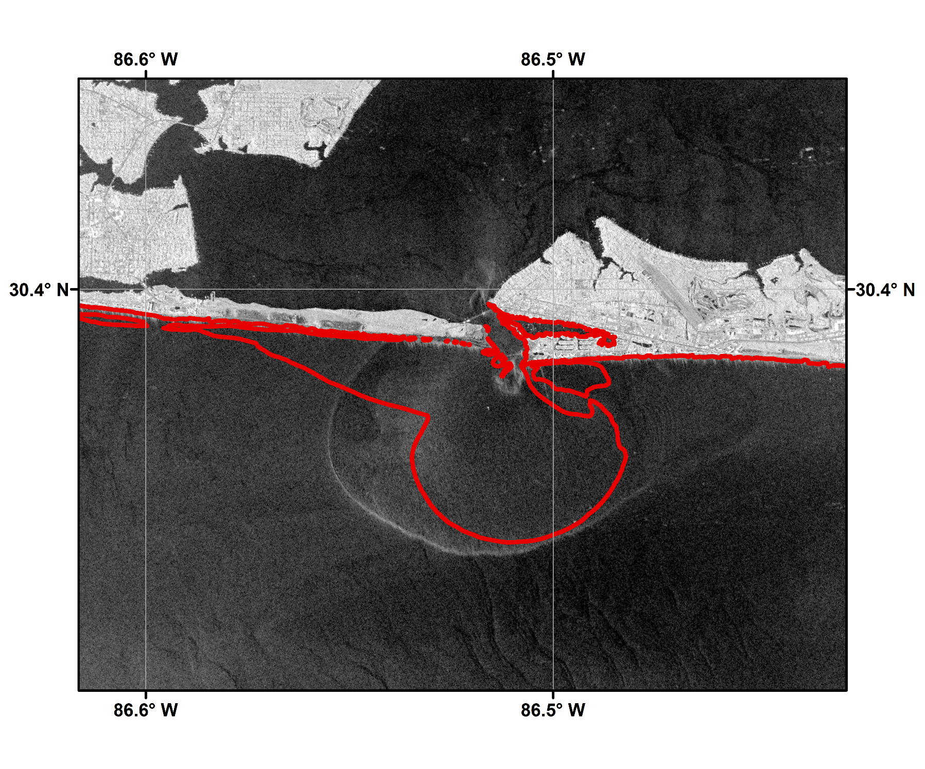
Model Validation: Satellite Imagery
12– 04–2013 11:34:20 GMT
33 psu
Source: COSMO-SkyMedâ¢ Product Â©ASI 2013 processed under license from ASI â Agenzia Spaziale Italiana. All rights reserved. Distributed by e-GEOS. Downlinked and processed by CSTARS.

Slide 17
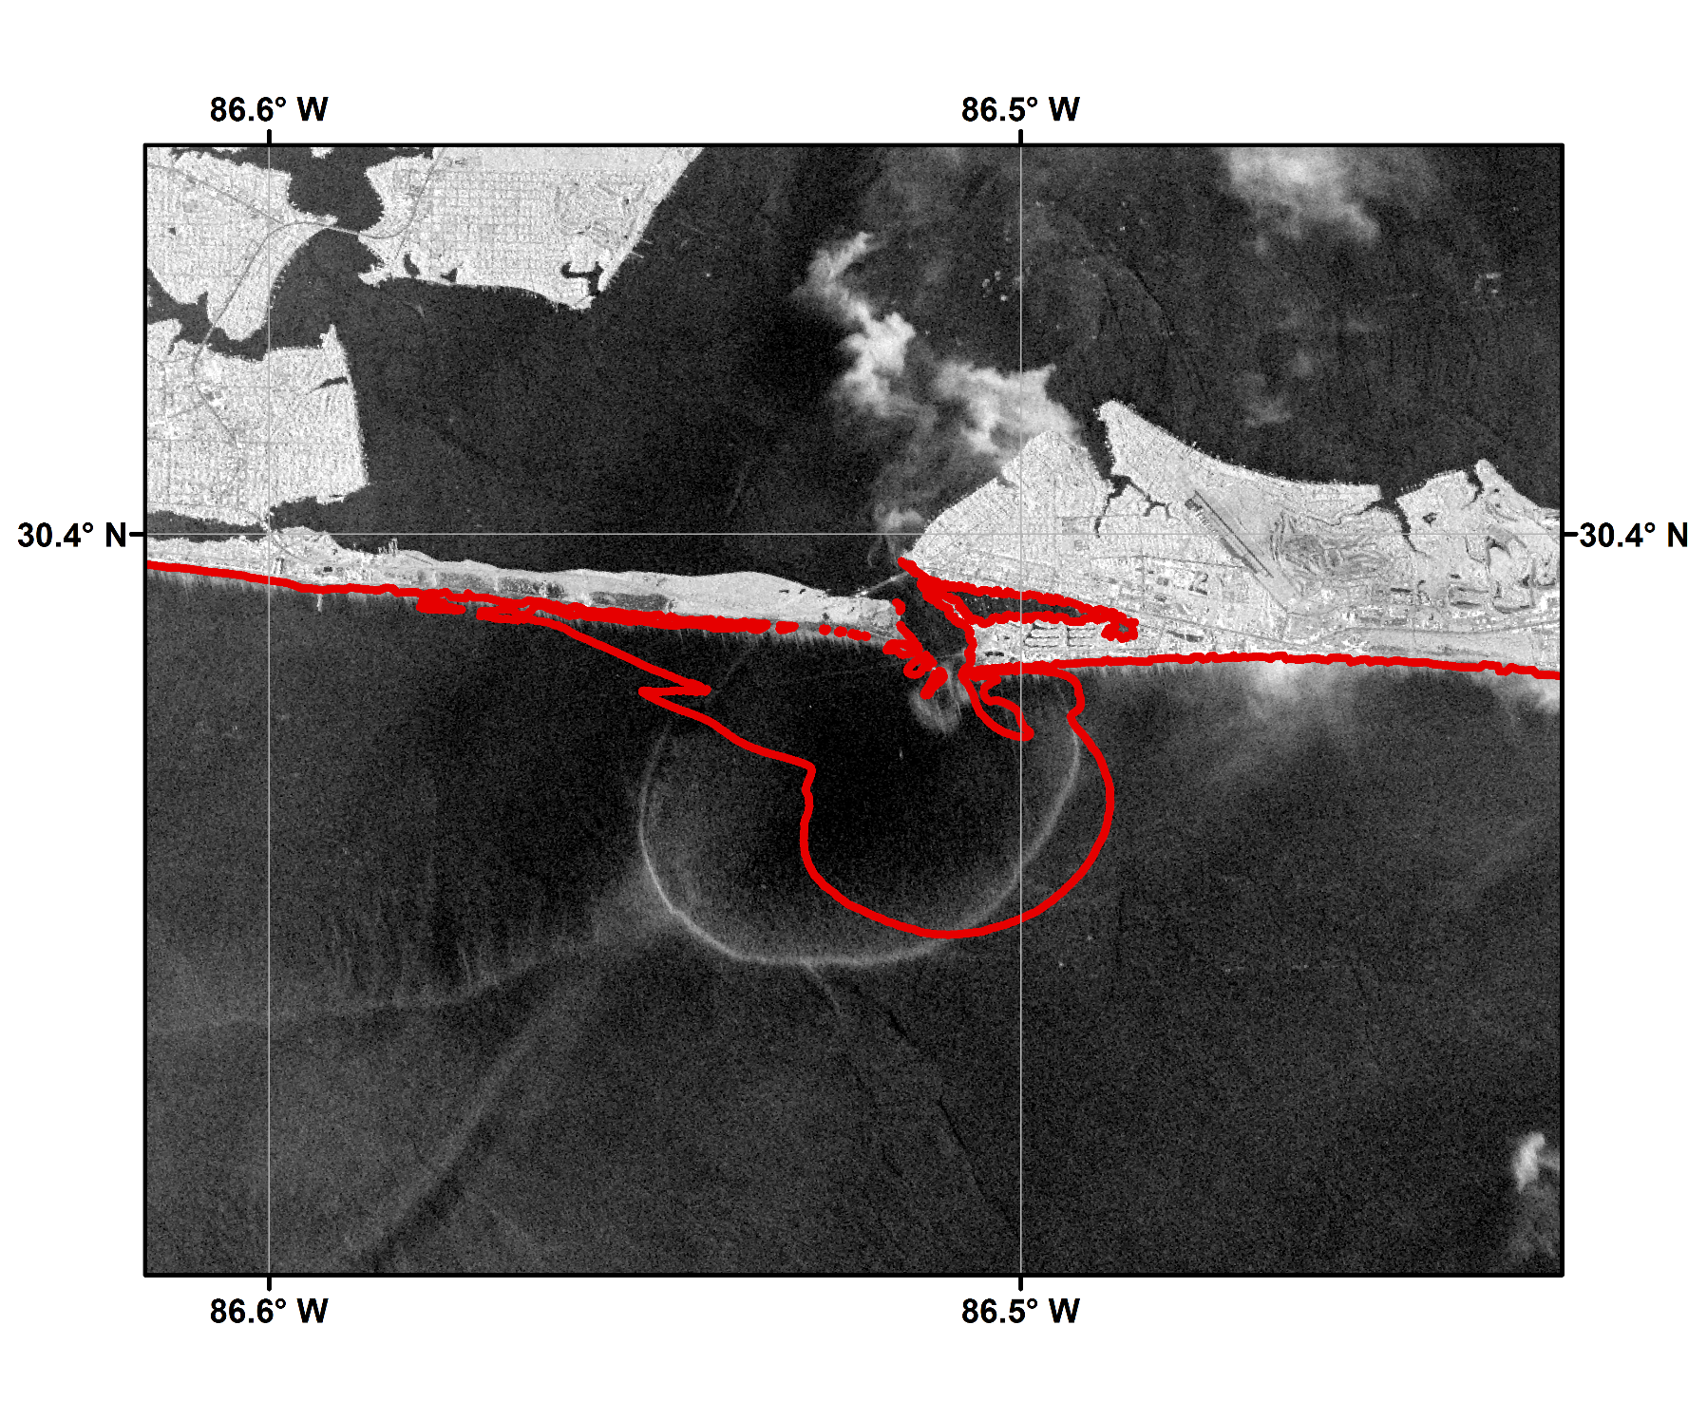
Model Validation: Satellite Imagery
12– 05–2013 11:34:19 GMT
33 psu
Source: COSMO-SkyMedâ¢ Product Â©ASI 2013 processed under license from ASI â Agenzia Spaziale Italiana. All rights reserved. Distributed by e-GEOS. Downlinked and processed by CSTARS.

Slide 18
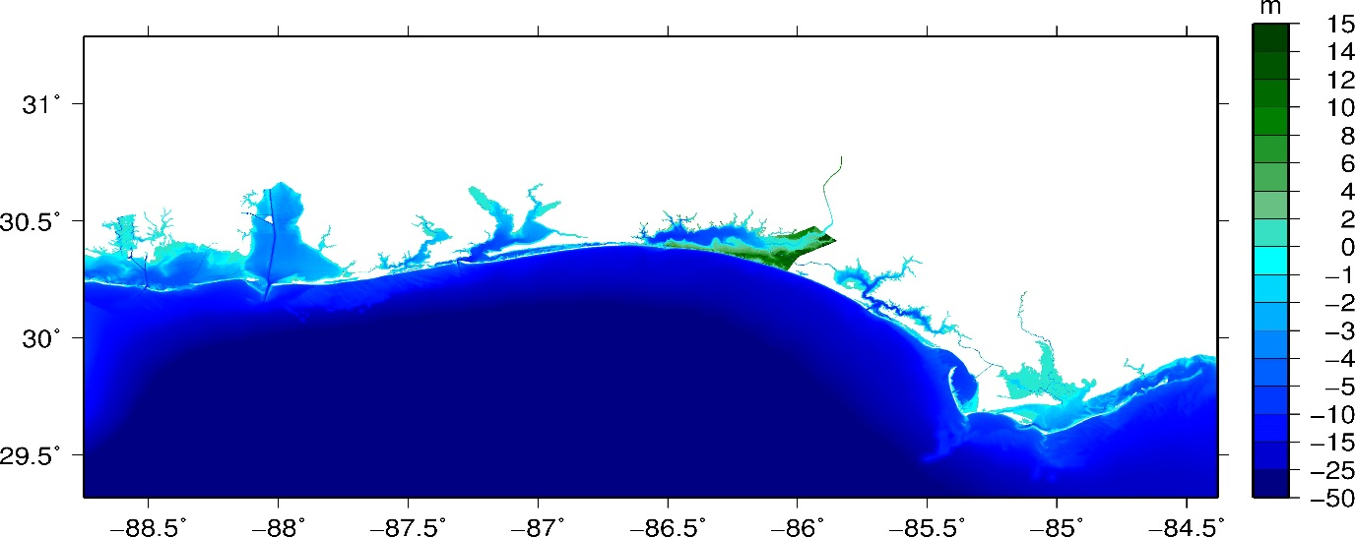
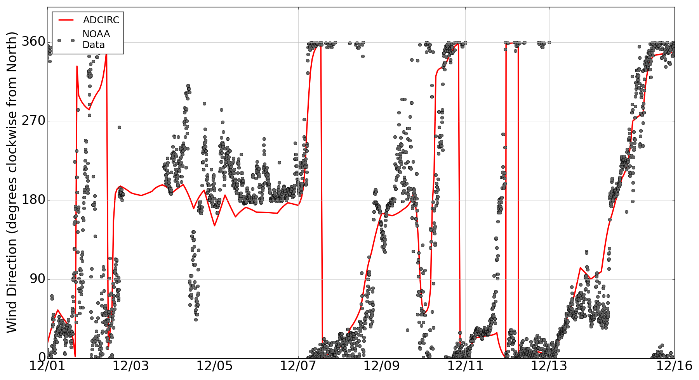
Factors affecting Plume Variability: Winds
Winter cold fronts over the Florida Panhandle cause multiple 360 degree reversals in wind directions during Dec 1-15
Pensacola
Notes:
Need to change picture of the grid

Slide 19
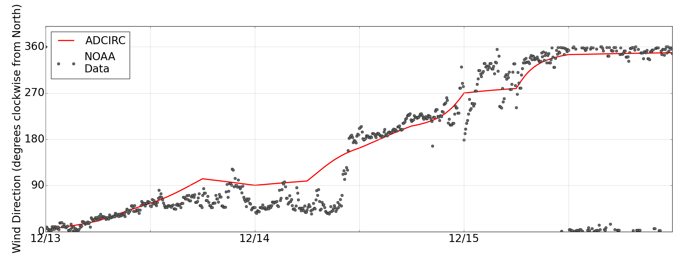
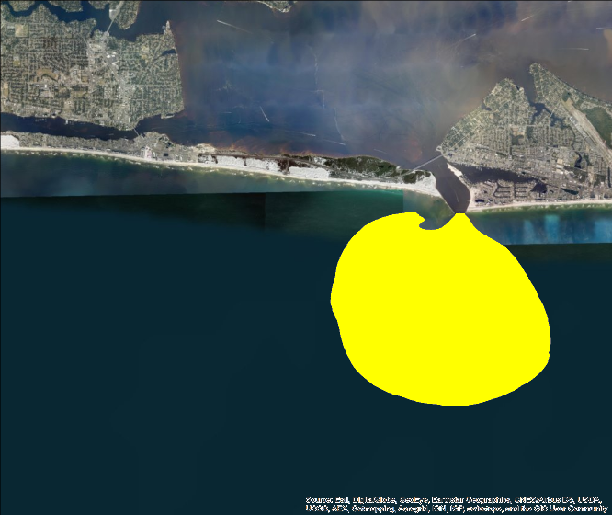
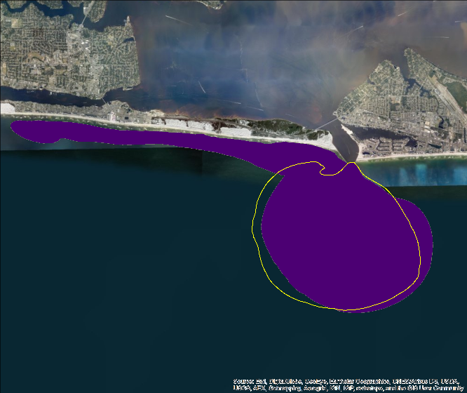
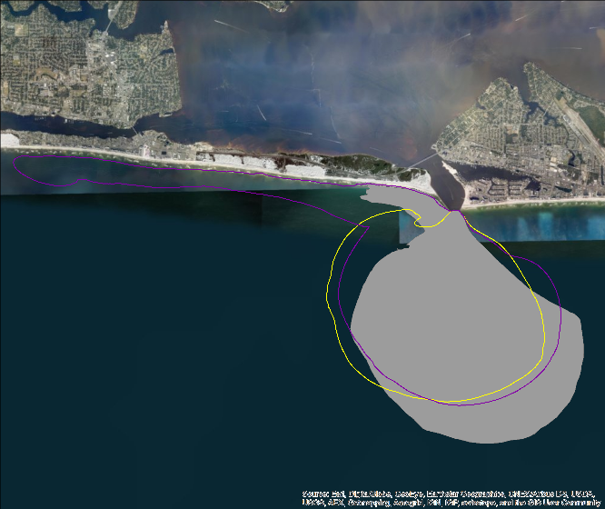
Factors affecting Plume Variability: Winds
December 13
December 14
December 15

Slide 20
Summary
Research Hypotheses and Objectives
The ebb-phase plume at Destin exhibits variability with changes in wind conditions
Aim of the present research is to quantify these changes during winter cold fronts
Modeling Density driven flows in Choctawhatchee Bay using 3D baroclinic ADCIRC
Model salinities show good agreement with observed vertical salinities
Plume signature predicted by the model matches the plume edges and offshore extents observed in satellite imagery
Quantifying variability in plume signature
Changes in wind direction caused by passing cold fronts causes changes in the plume signature
Winds with an easterly component push the plume to the west of the inlet
Northerly winds push the plume offshore
Model salinities are in agreement with plume behavior observed during SCOPE
Future work will explore plume variability in the absence of winds

Slide 21
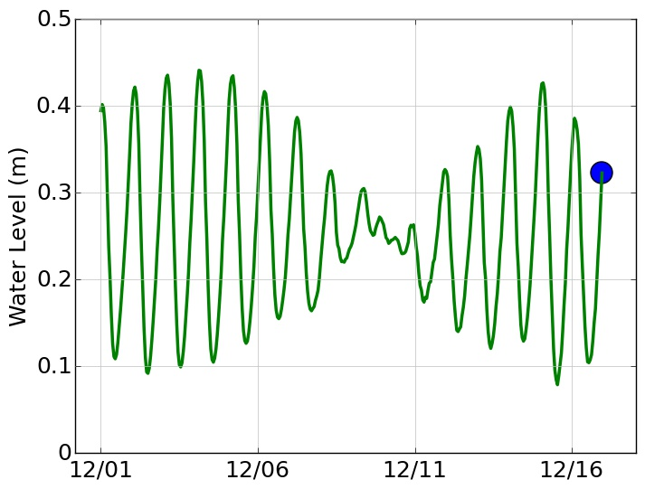
Factors affecting Plume Variability: Tides

Slide 22
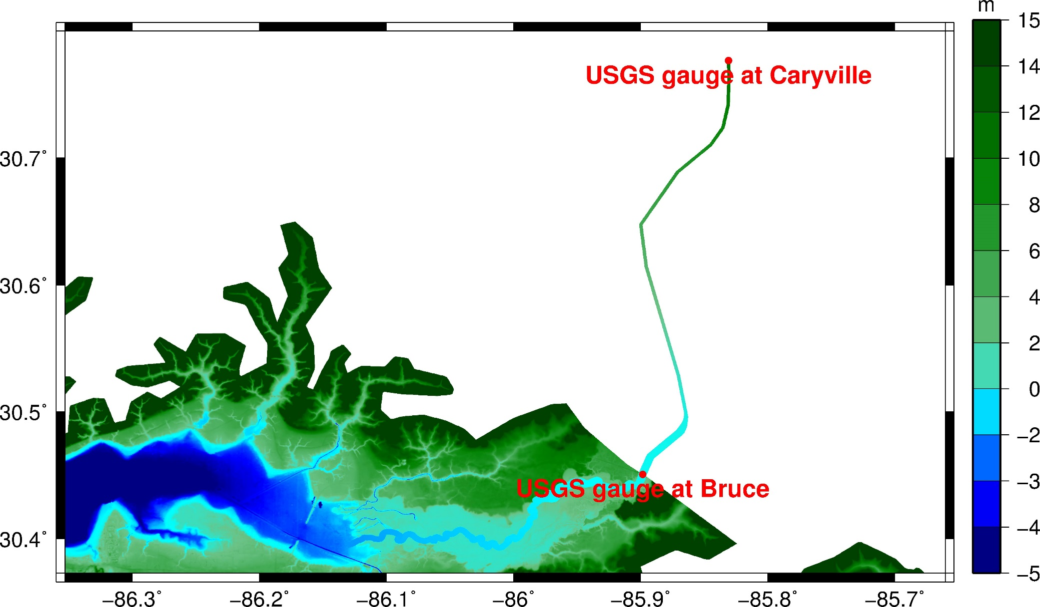
Choctawhatchee River

