Slide 1
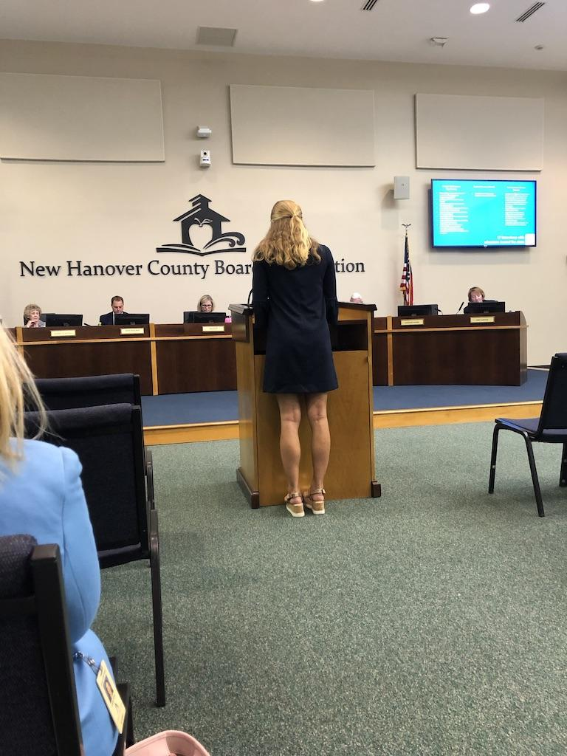
Supporting Immigrant Students and Their Learning Outcomes:
A Look at Chapel Hill/Carrboro and New Hanover County Public Schools
Hannah Marable
SURF Fellow
Global Studies and Hispanic Literatures and Cultures
Advised by Hannah Gill
Institute for the Study of the Americas

Slide 2
North Carolina is the fifth-fastest growing state in the country. Nearly 8% of residents are foreign-born. Immigrant students are just as important as native born students - but they have particular needs we must address to facilitate their success in US schools.
How are North Carolina schools working to improve the learning outcomes of immigrant and English-learner (EL) students? What are the schools doing to support these children and their families?

Slide 3
Results
My interviews with teachers, administrators, and support staff from CHCCS helped me understand methods for support English-learner (EL) students. I learned about executive parent groups at Carrboro Elementary School, newcomer classrooms at Northside Elementary School, and an county-wide emphasis on bilingual hiring - and much more.
My interviews in New Hanover County Schools helped me to understand some of the challenges to serving English-learning students in my home county. These challenges include: a lack of diversity and bilingualism among employees - especially in leadership roles, a struggle to recruit Hispanic and African-Americans families to the Spanish immersion program at the International School at Gregory, and “bigger fish to fry” - the county has bigger concerns than a small, but growing EL student population.
I presented five recommendations based on my summer research to the New Hanover County Board of Education on August 6. I shared numbers regarding the EL and newcomer population in the county, compared NHCS EL’s progress towards exiting the EL designation with the state and the southeast region, and offered five suggestions for strengthening support for immigrant and EL students. I hoped that my presentation would get the Board invested in being proactive about creating strong supports for ELs as the population continues to grow in my county. I wanted to inform the Board, and other members of the community, about how schools around the state are supporting English-learners, and propel them to consider adopting some of these methods.
There is lots more to be done - more North Carolina schools to visit, more teachers to interview, more recommendations to be made, and more minds to be changed. I barely scratched the surface on the topic this summer, and would love to continue in the future.

