Slide 1
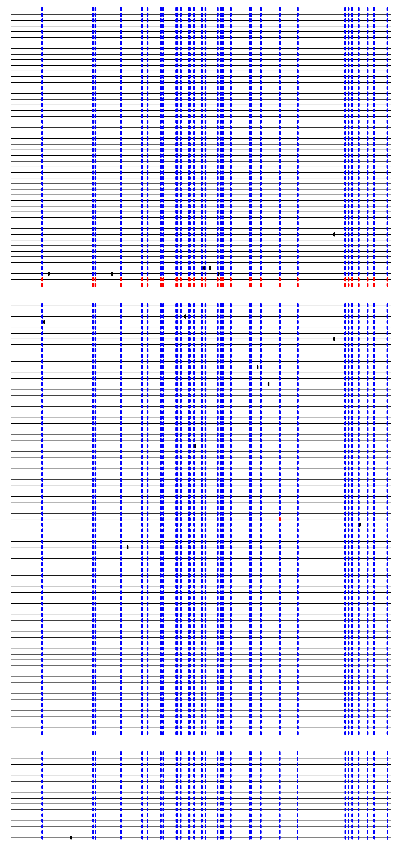
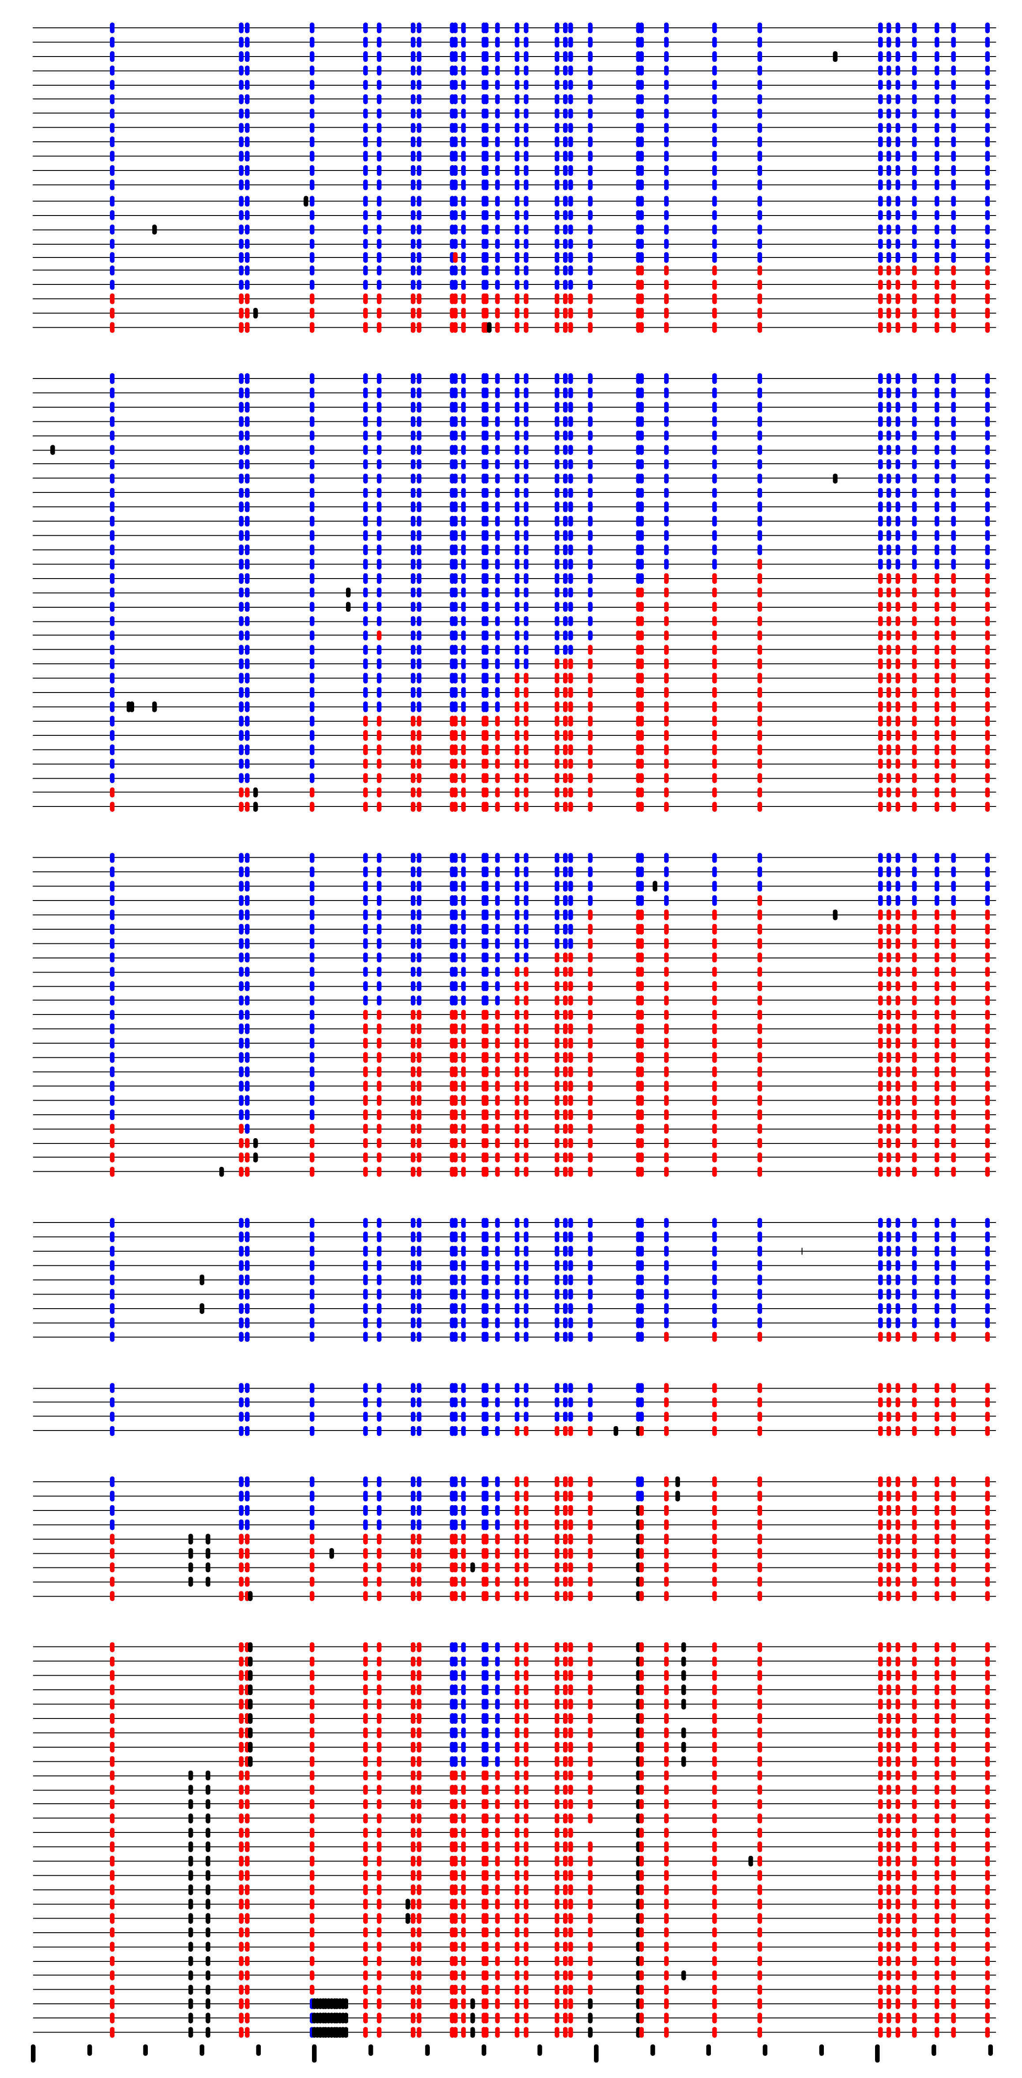
Major T/F
Minor T/F
0
21
28
35
42
49
134
197
442
0
100
200
300
Base number

