Slide 1
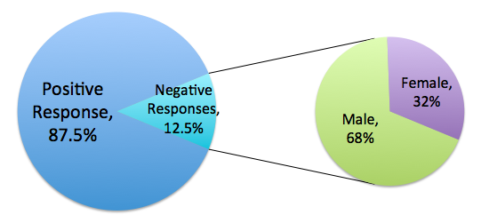
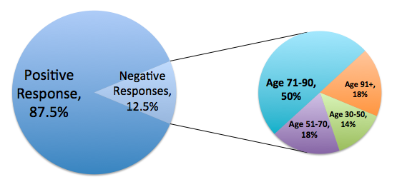
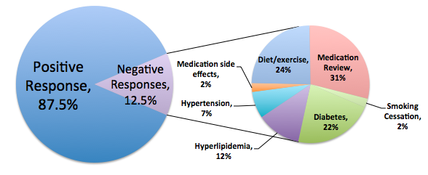
Perceptions of a pharmacist in an ambulatory care setting
Brianna McQuade PharmD Candidate, Kim Kelly PharmD, BCPS
WakeMed Health and Hospitals, Raleigh, North Carolina
INTRODUCTION
RESULTS
The goal of the patient centered medical home model (PCMH) is to provide comprehensive and robust healthcare to patients through relationships with medical professionals¹
Pharmacists can perform medication assessments and participate in clinical practices on the outpatient level to optimize overall health outcomes
Pharmacist services utilized in the PCMH demonstrate improvement of patient health outcomes and lessened physician burden²
While patient outcomes and physician benefits have been explored, patient perception of these pharmacist services is currently unknown
The purpose of this study was to determine how patients view and benefit from pharmacists as members of their healthcare team in three primary care settings in Raleigh, North Carolina
TABLE 2. Results of the 12 survey questions
FIGURE 1. Percentage of total responses that were negative* according to gender
 | Yes, n/total responses (%) | No*, n/total responses (%) | Somewhat*, n/total responses (%)
Did the pharmacist answer all your questions? | 16/16 (100) | 0/16 (0) | 0/16 (0)
Do you understand your medications better than you did before the consultation? | 11/14 (79) | 1/14 (7) | 2/14 (14)
Did the pharmacist explain what to do if you experience side effects from your medication? | 9/13 (69) | 4/13 (31) | 0/13 (0)
Did you learn anything unique about your medication that you didn’t know before? | 6/13 (46) | 4/13 (31) | 3/13 (23)
Do you understand your treatment goals better than you did before the consultation? | 15/16 (94) | 1/16 (6) | 0/16 (0)
Do you understand your medication regimen better than you did before? | 10/13 (77) | 2/13 (15) | 1/13 (8)
Did the pharmacist explain things in ways you were able to understand? | 16/16 (100) | 0/16 (0) | 0/16 (0)
Would you like to see a pharmacist again for a consultation like you had today? | 14/16 (88) | 2/16 (12) | N/A
FIGURE 2. Percentage of total responses that were negative* according to age
METHODS
The study format was a survey administered via interview by the primary investigator following a pharmacist consultation service
16 patients met with a pharmacist for a consultation during the study period of August 2012
The reason for the consultation could be anything drug or disease-state related
Patients were eligible if they had a pharmacist encounter, were over age 18, and spoke fluent English
After the consultation, the pharmacist left the room and the primary investigator asked a series of twelve questions relating to the encounter
The questions were multiple choice format with one open-ended question relating to suggestions for improvement
 | Too short*, n/total responses (%) | Too long*, n/total responses (%) | About right, n/total responses (%)
Would you say the time allotted with the pharmacist was too short, too long, or about right? | 1/16 (6) | 0/16 (0) | 15/16 (94)
 | Not at all comfortable*, n/total responses (%) | Not very comfortable*, n/total responses (%) | Somewhat comfortable*, n/total responses (%) | Very comfortable n/total responses (%)
How comfortable did you feel with the pharmacist? | 0/16 (0) | 1/16 (6) | 0/16 (0) | 15/16 (96)
FIGURE 3. Percentage of total responses that were negative* according to reason for consultation
 | Not helpful*, n/total responses (%) | Somewhat helpful*, n/total responses (%) | Very helpful, n/total responses (%)
How helpful was the information the pharmacist provided on your treatment goals? | 0/16 (0) | 3/16 (19) | 13/16 (81)
TABLE 1. Patient demographics
*Considered negative responses
 | n/total (%)
Male | 8/16 (50)
Age 30-50 years | 4/16 (25)
Age 51-70 years | 4/16 (25)
Age 71-90 years | 7/16 (44)
Age 91+ years | 1/16 (6)
Average age: 66 years
CONCLUSION
The majority of the responses to the pharmacist and the pharmacist encounter were positive (87.5%)
The responses indicate that patients find the pharmacist informative, helpful, and comfortable to interact with
Males and those between the ages of 71-90 years old were more likely to answer negatively
No patients had any recommendations for areas of improvement, so a further area of study could be to determine how to maximize the pharmacist benefit in an ambulatory care setting for males and the elderly
REFERENCES
1. Berdine H, et al. The Pharmacists’ Role in the Patient-Centered Medical Home (PCMH). Ann Pharmacother. 2012;46:723-50.
2. Trygstad T. The Role of the Pharmacist in CCNC. NC Med J. 2009;70:3:274-76.

