Slide 1
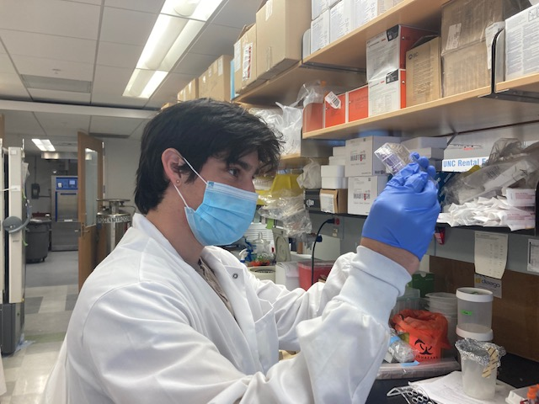
NSP2 Expression and Mutation to Determine Regions of Interest for Cytopathic Effects
Ian Klevans, Biology
Dr. Mark Heise, Genetics

Slide 2
Research Background
Chikungunya Virus (CHIKV) is a virus that causes arthralgia, fever, and may have long-term side effects that can be detrimental to human health.
CHIKV’s nonstructural protein 2 (nsp2) has an ability of stopping host cell transcription by degrading part of the cell’s machinery
It is important to determine the regions of the CHIKV genome that are responsible for stopping host cell transcription so that drug companies can target these regions with novel therapies
We attempted to create a expression system for CHIKV nsp2 that contained mutations in certain regions of interest
This expression system, or vector, allowed us to observe the effects of these mutant viral proteins on cells
Genome: the entire gene sequence of an organism or virus
Transcription: cellular process of converting DNA to RNA that is eventually used to make proteins
Expression System: method of expressing a protein of interest using a ‘skeleton’ of another genome, in this case it is the cytomegalovirus genome.

Slide 3
Results
We successfully created an expression system for mutant viral proteins
We successfully created mutants of CHIKV nsp2
We optimized the conditions necessary for introducing said viral proteins to cells through a process called transfection
This research with be expanded upon in Fall 2022/Spring 2023 where we will test the mutants for their ability to stop host cell transcription
The results we find from testing these mutants could allow drug companies to create compounds that target specific regions in viral genomes
Drugs targeting the Chikungunya Virus genome could potentially provide a cure which currently does not exist

