Slide 1
Engaging Future Librarians in Engaged Scholarship
Shannon Delaney, Barbara Rochen Renner, and Lee Richardson
UNC Health Sciences Library
Mid-Atlantic Chapter of the Medical Library Association Annual Meeting
October 5-7, 2019

Slide 2
Introduction
Students need hands-on experience
Academic libraries are increasingly involved in community engaged scholarship
Important to involve students to prepare them for academic library careers
HSL found a way to provide opportunities for students and new professionals with an ongoing project

Slide 3
Methods
Your Health Radio ® https://yourhealthradio.org/
Librarians manage and contribute to the companion blog
Librarians create posts to expand radio show topics or highlight a national health observance
Librarians mentor students and new professionals in creating posts
Provides well-rounded experience
May increase breadth of topics covered in the blog

Slide 4
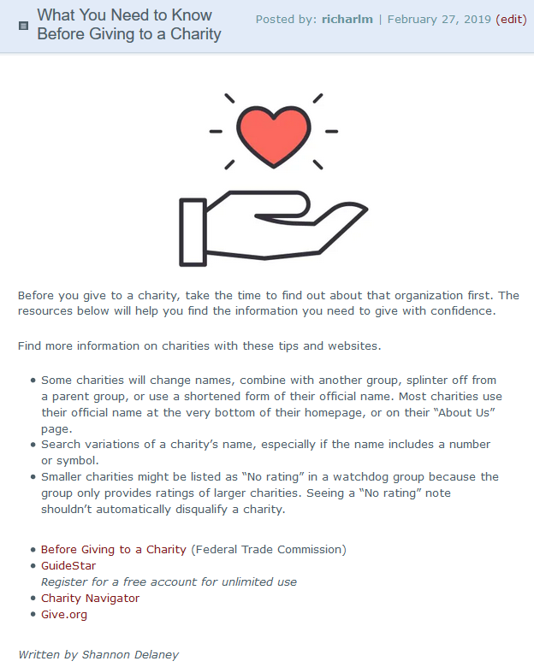
Topic derived from radio show content.
Student researched topic and created post.
Your Health Radio librarian team reviewed content with student before posting.
Student gets author credit
https://yourhealthradio.org/2019/02/27/what-you-need-to-know-before-giving-to-a-charity/

Slide 5
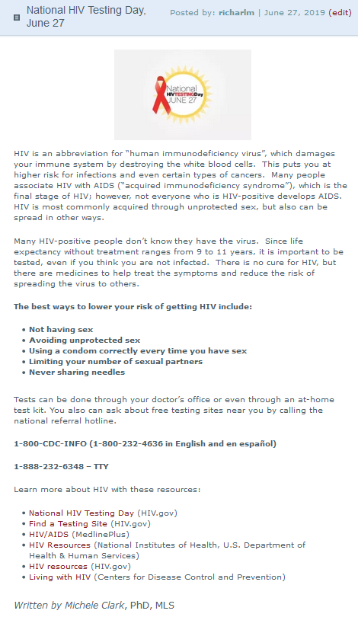
National health observance topic.
New professional researched topic and created post.
Your Health Radio librarian team reviewed content with student before posting.
New professional gets author credit
https://yourhealthradio.org/2019/06/27/national-hiv-testing-day-june-27/

Slide 6
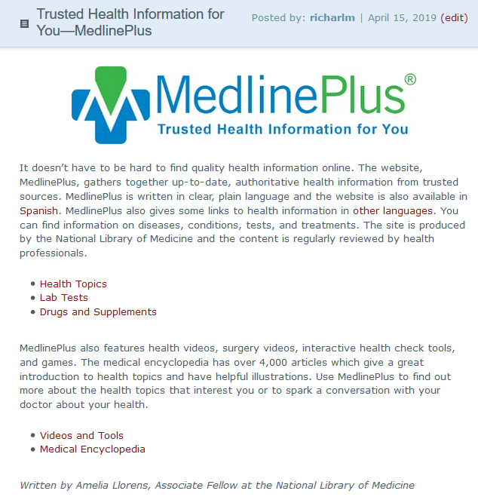
Consumer health service, MedlinePlus, is the topic.
Trainee/new professional researched topic and created post.
Your Health Radio librarian team reviewed content with student before posting.
Trainee/new professional gets author credit
https://yourhealthradio.org/2019/04/15/trusted-health-information-for-you-medlineplus/

Slide 7
Results
Two students and one new professional have contributed, with more planned
Students use or learn new skills
Internet searching
Website evaluation
Consumer health practices
Health literacy
Students list on their resumes – may make them more marketable when job searching

Slide 8
Everyone Benefits from this Outreach Project
University
Library
Radio show librarian team
Listeners of the show and everyone who interacts with the blog
Library students and new professionals

Slide 9
Thank You!
Shannon Delaney Graduate Research Assistant shanndel@live.unc.edu
Barbara Rochen Renner
Library Services Evaluation Specialist and Liaison, Allied Health Sciences
brrenner@email.unc.edu
Lee Richardson
Information Discovery and Metadata Librarian
richarlm@email.unc.edu

