Slide 1

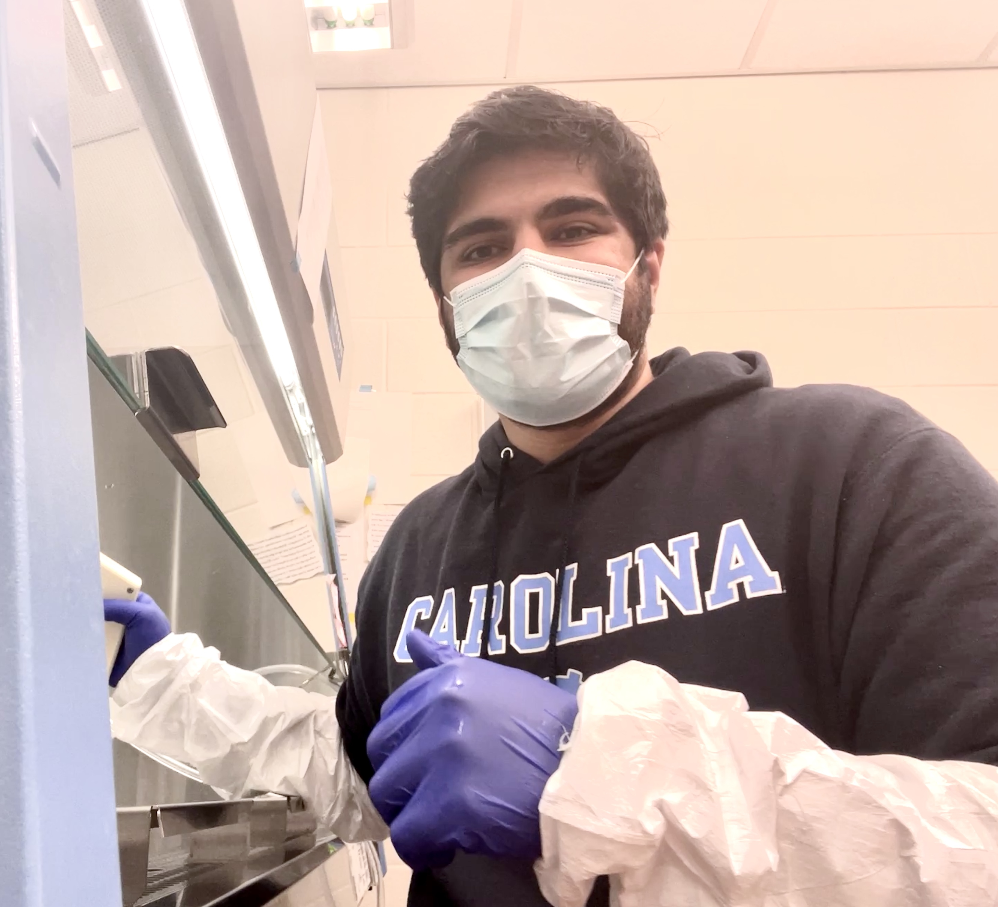

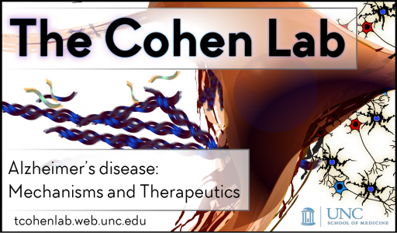
Investigating Toxicant Induced Intracellular Zinc Modulation and Resultant TDP-43 Dysfunction Linked to
Amyotrophic Lateral Sclerosis
Omeed Arooji
Neuroscience B.S.; Biology and Chemistry Minors
Advisors: Dr. Todd Cohen and Dr. Giulia Fragola
Dept. of Neurology UNC School of Medicine

Slide 2
Research Questions and Why?
2
Background
Amyotrophic Lateral Sclerosis (ALS) is characterized by upper motor neuron degeneration in the central nervous system.
Symptoms ultimately result in pneumonia and fatal respiratory failure
About 2-3 per 100,000 individuals are afflicted with ALS, usually following a fatal prognosis of 2 to 5 years after symptom onset.
TAR-DNA binding protein-43 (TDP-43) aggregation is implicated in ALS
The mechanisms for TDP-43 dysfunction are not well understood
Our Questions and Why
1. Does our toxicant, TS5, induce modulation of intracellular Zn²⁺ levels and does this produce insoluble forms of TDP-43?
2. Do the effects of a Zn²⁺ chelator (TPEN) rescue pathological forms of TDP-43?
Investigating exposure to TS5, an environmental toxin associated with zinc, and its relation to TDP-43 dysfunction will expand upon our knowledge of the poorly understood biochemical mechanism underlying ALS pathogenesis.
Observing the effects of Zn²⁺ chelators on TDP-43 rescue may build toward development of a novel therapeutic.

Slide 3
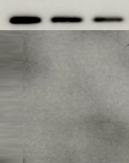

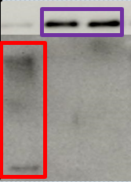

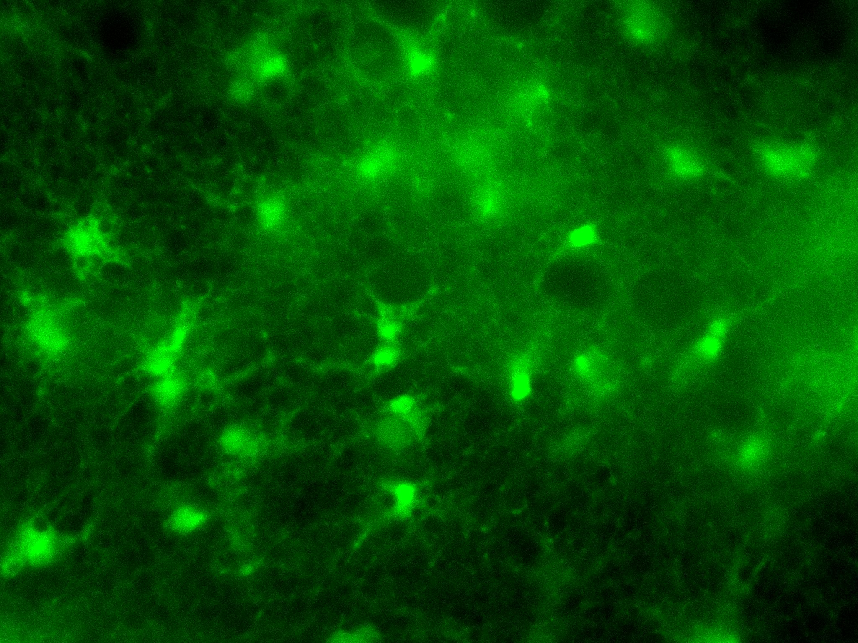
Our Findings
3
Treatments
Our findings suggest that, in cortical mouse neurons, exposure to TS5 can induce TDP-43 aggregation evident by the presence of TDP-43. Addition of the Zn²⁺ chelator TPEN and the Cu²⁺ chelator TET appear to rescue TDP-43 from the dysfunctional state, suggesting a broader involvement of bivalent metals in ALS pathology.
Stains for Zn²⁺ ions in the cytoplasm using the fluorescent dye NewPort Green suggests that TS5 increases intracellular Zn²⁺ ion concentrations, though the mechanism for this is not understood. Further studies restricting Zn²⁺ ion pathways into the cytoplasm may yield a better understanding of this synergistic mechanism of TDP-43 dysfunction.
Co-treatments
Soluble Fraction
Insoluble Fraction
Soluble presence of TDP-43 diminishes greatly with exposure to TS5. Insoluble aggregates form. Addition of ZnCl to TS5 treatment appear to exacerbate the progression into insoluble TDP-43 compared to the TS5/DMSO control.
Addition of the co-treatments TPEN and TET, metal chelators with affinities for both Zn²⁺ and Cu²⁺ ions, appear to rescue TDP-43 into the soluble fraction.
No Treatment (Control)
TS5 (50 μM) Treated
TS5 (2.5 μM) + ZnCl (100 μM) Treated
*** Images of ZnCl Treatments alone did not yield any noticeable change in image intensity. We speculate TS5 increases zinc ion uptake or releases zinc ions from intracellular compartments.

